Slide 1
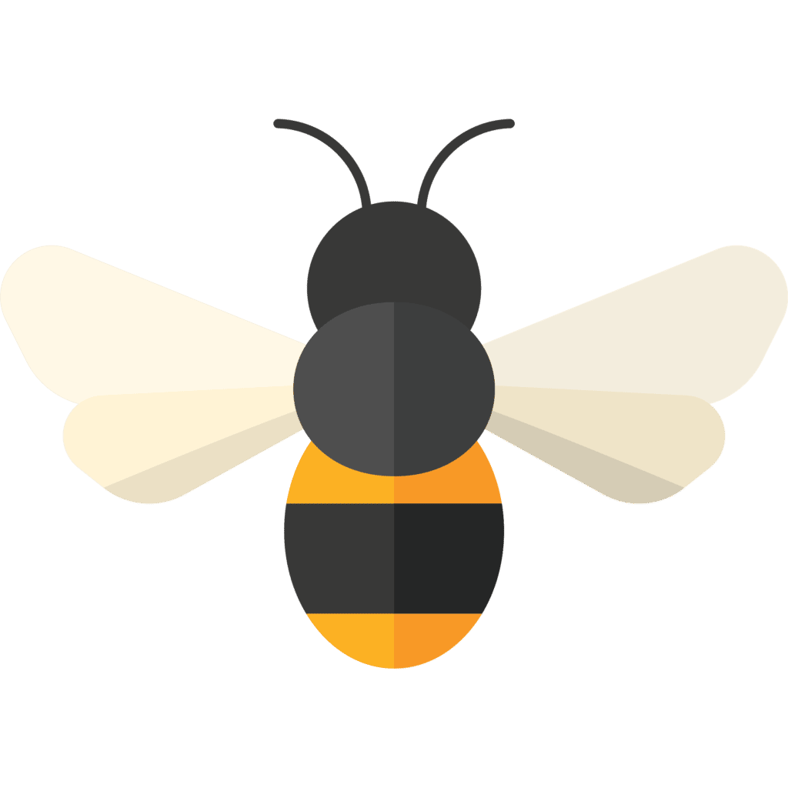




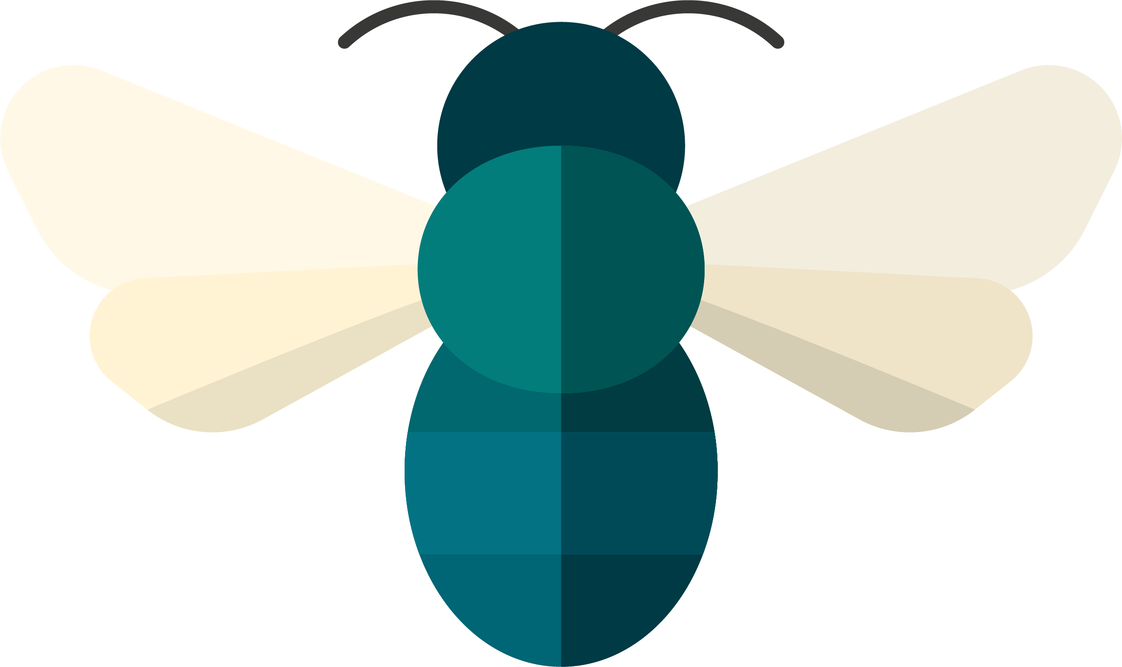



Counting in the
Great Southeast Pollinator Census
Becky Griffin
beckygri@uga.edu
National Coordinator for
The Great Southeast Pollinator Census

Slide 2
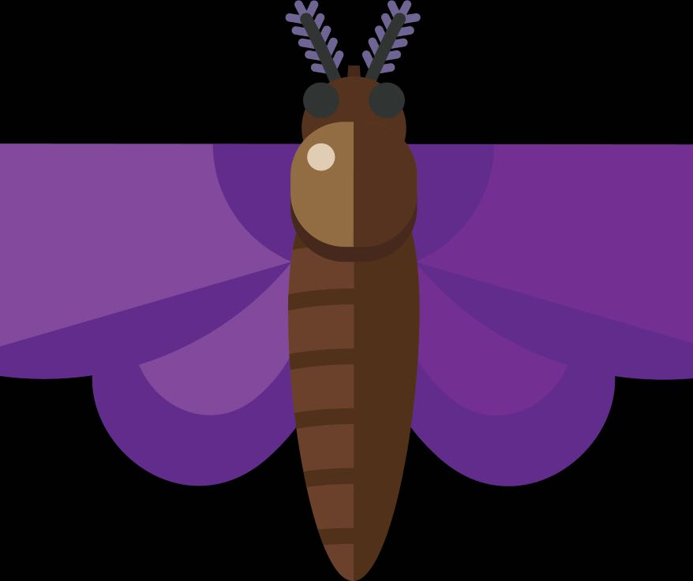

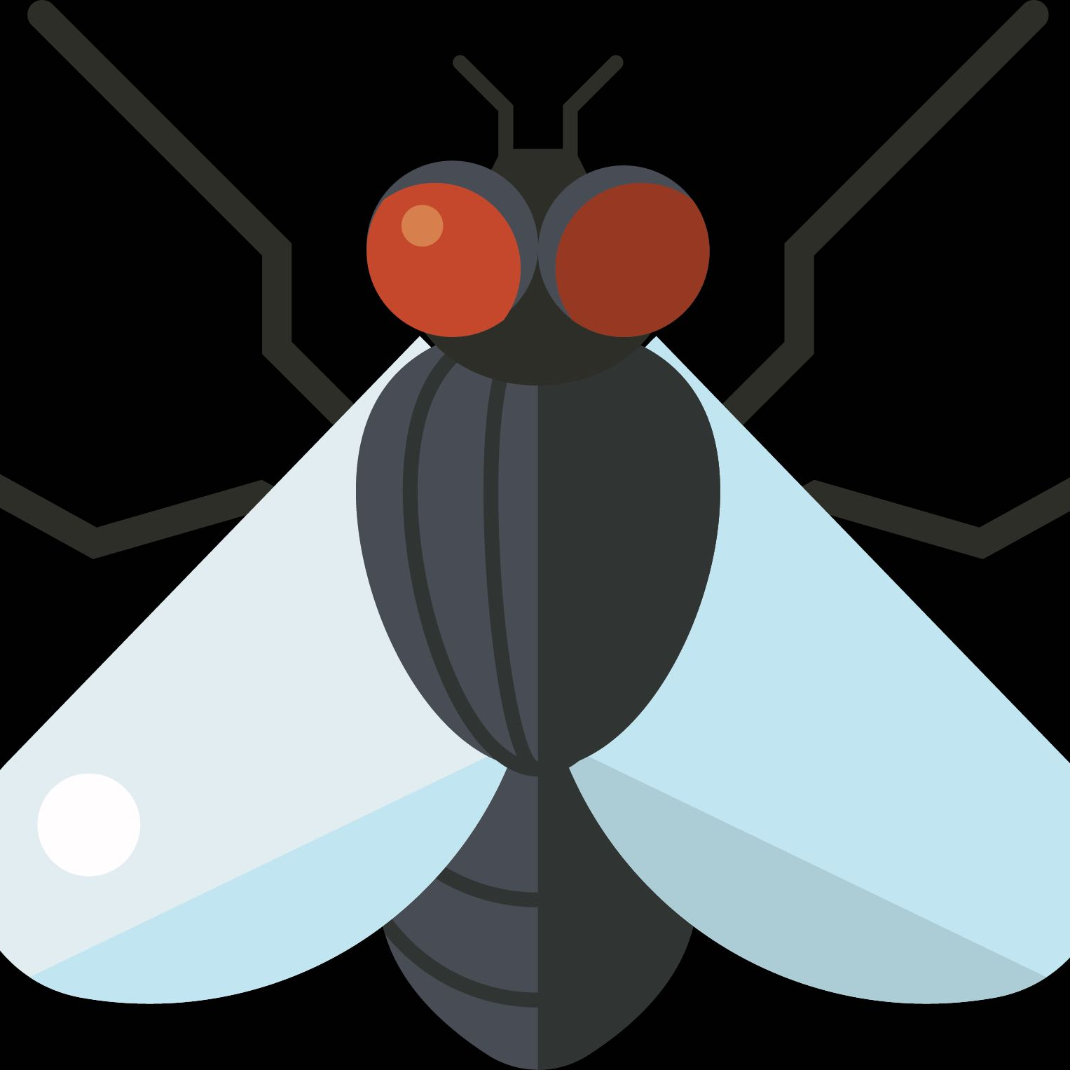


Census Project Goals
To create or add sustainable pollinator habitat.
To increase the entomological literacy of our citizens.
To generate useful data about our pollinator populations.
Notes:
Three goals of the Census which was started in 2019 in Georgia.

Slide 3
A community science project where participants count insects that land on a pollinator plant for 15 minutes, putting these insects into categories:
Carpenter bees - Xylocopa spp. Latrelle (Hymenoptera: Apidae)
Bumble bees - Bombus spp. Latrelle (Hymenoptera: Apidae)
Honey bees - Apis mellifera L. (Hymenoptera: Apidae)
Small bees - (Hymenoptera)
Wasps - (Hymenoptera: Vespidae)
Flies - (Diptera)
Butterflies/moths - (Lepidoptera)
Other insects

Slide 4
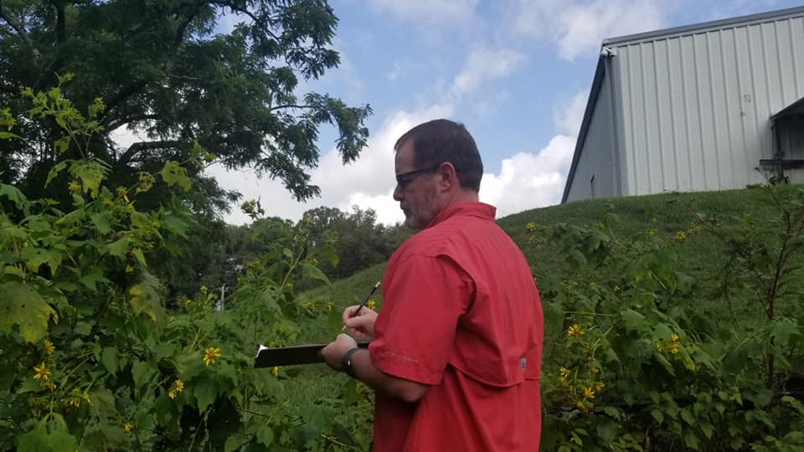
Participants find a favorite pollinator plant. They count and identify the insects that land on that plant for 15 minutes. They upload the counts to the project website.

Slide 5

https://GSePC.org

Slide 6
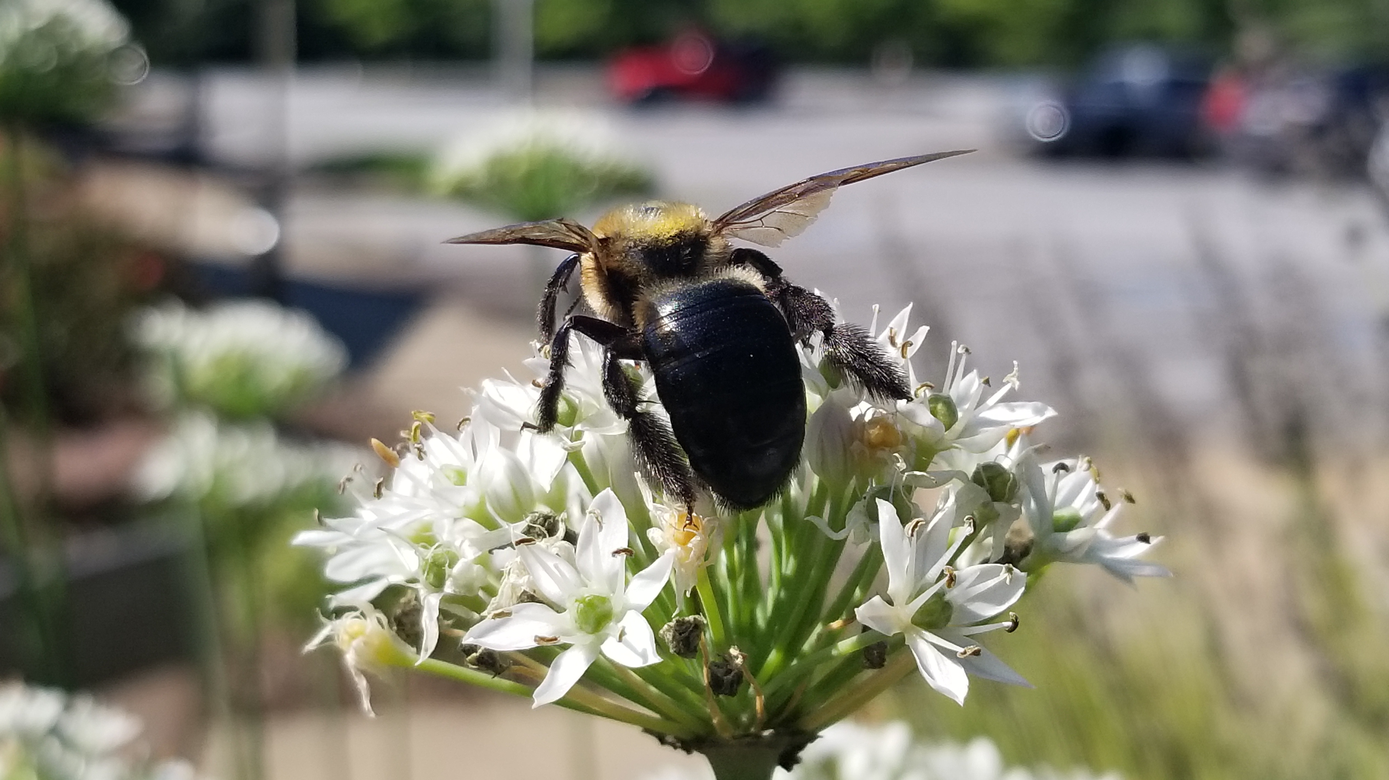
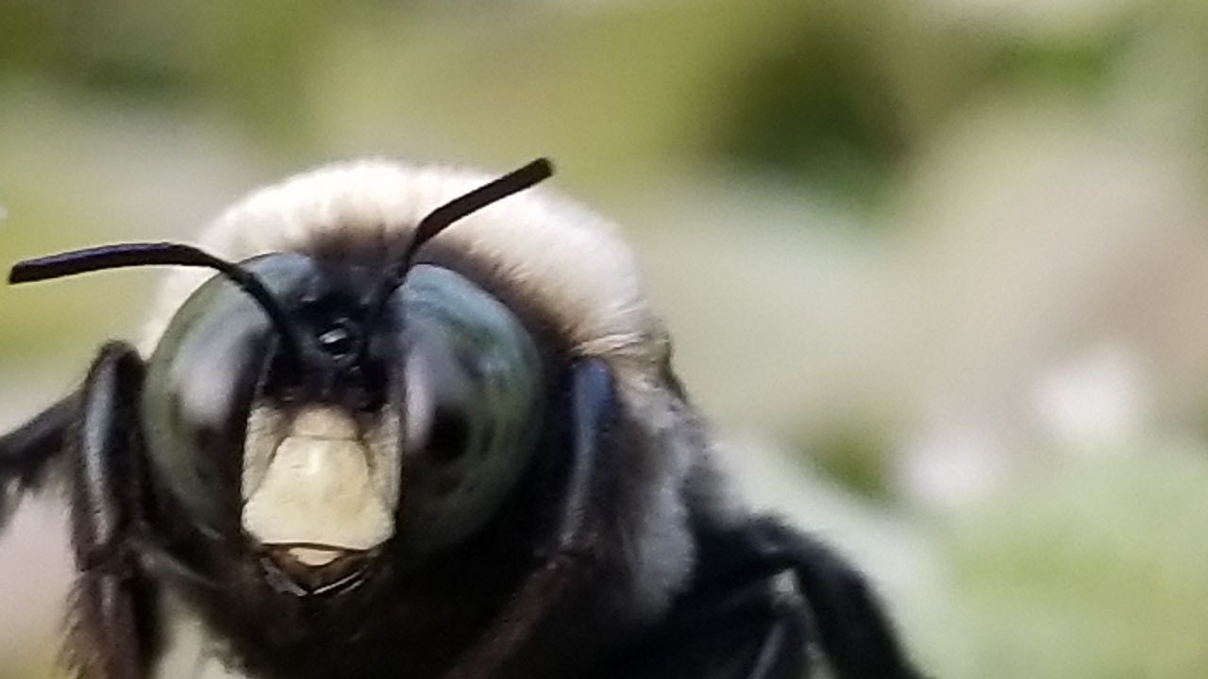
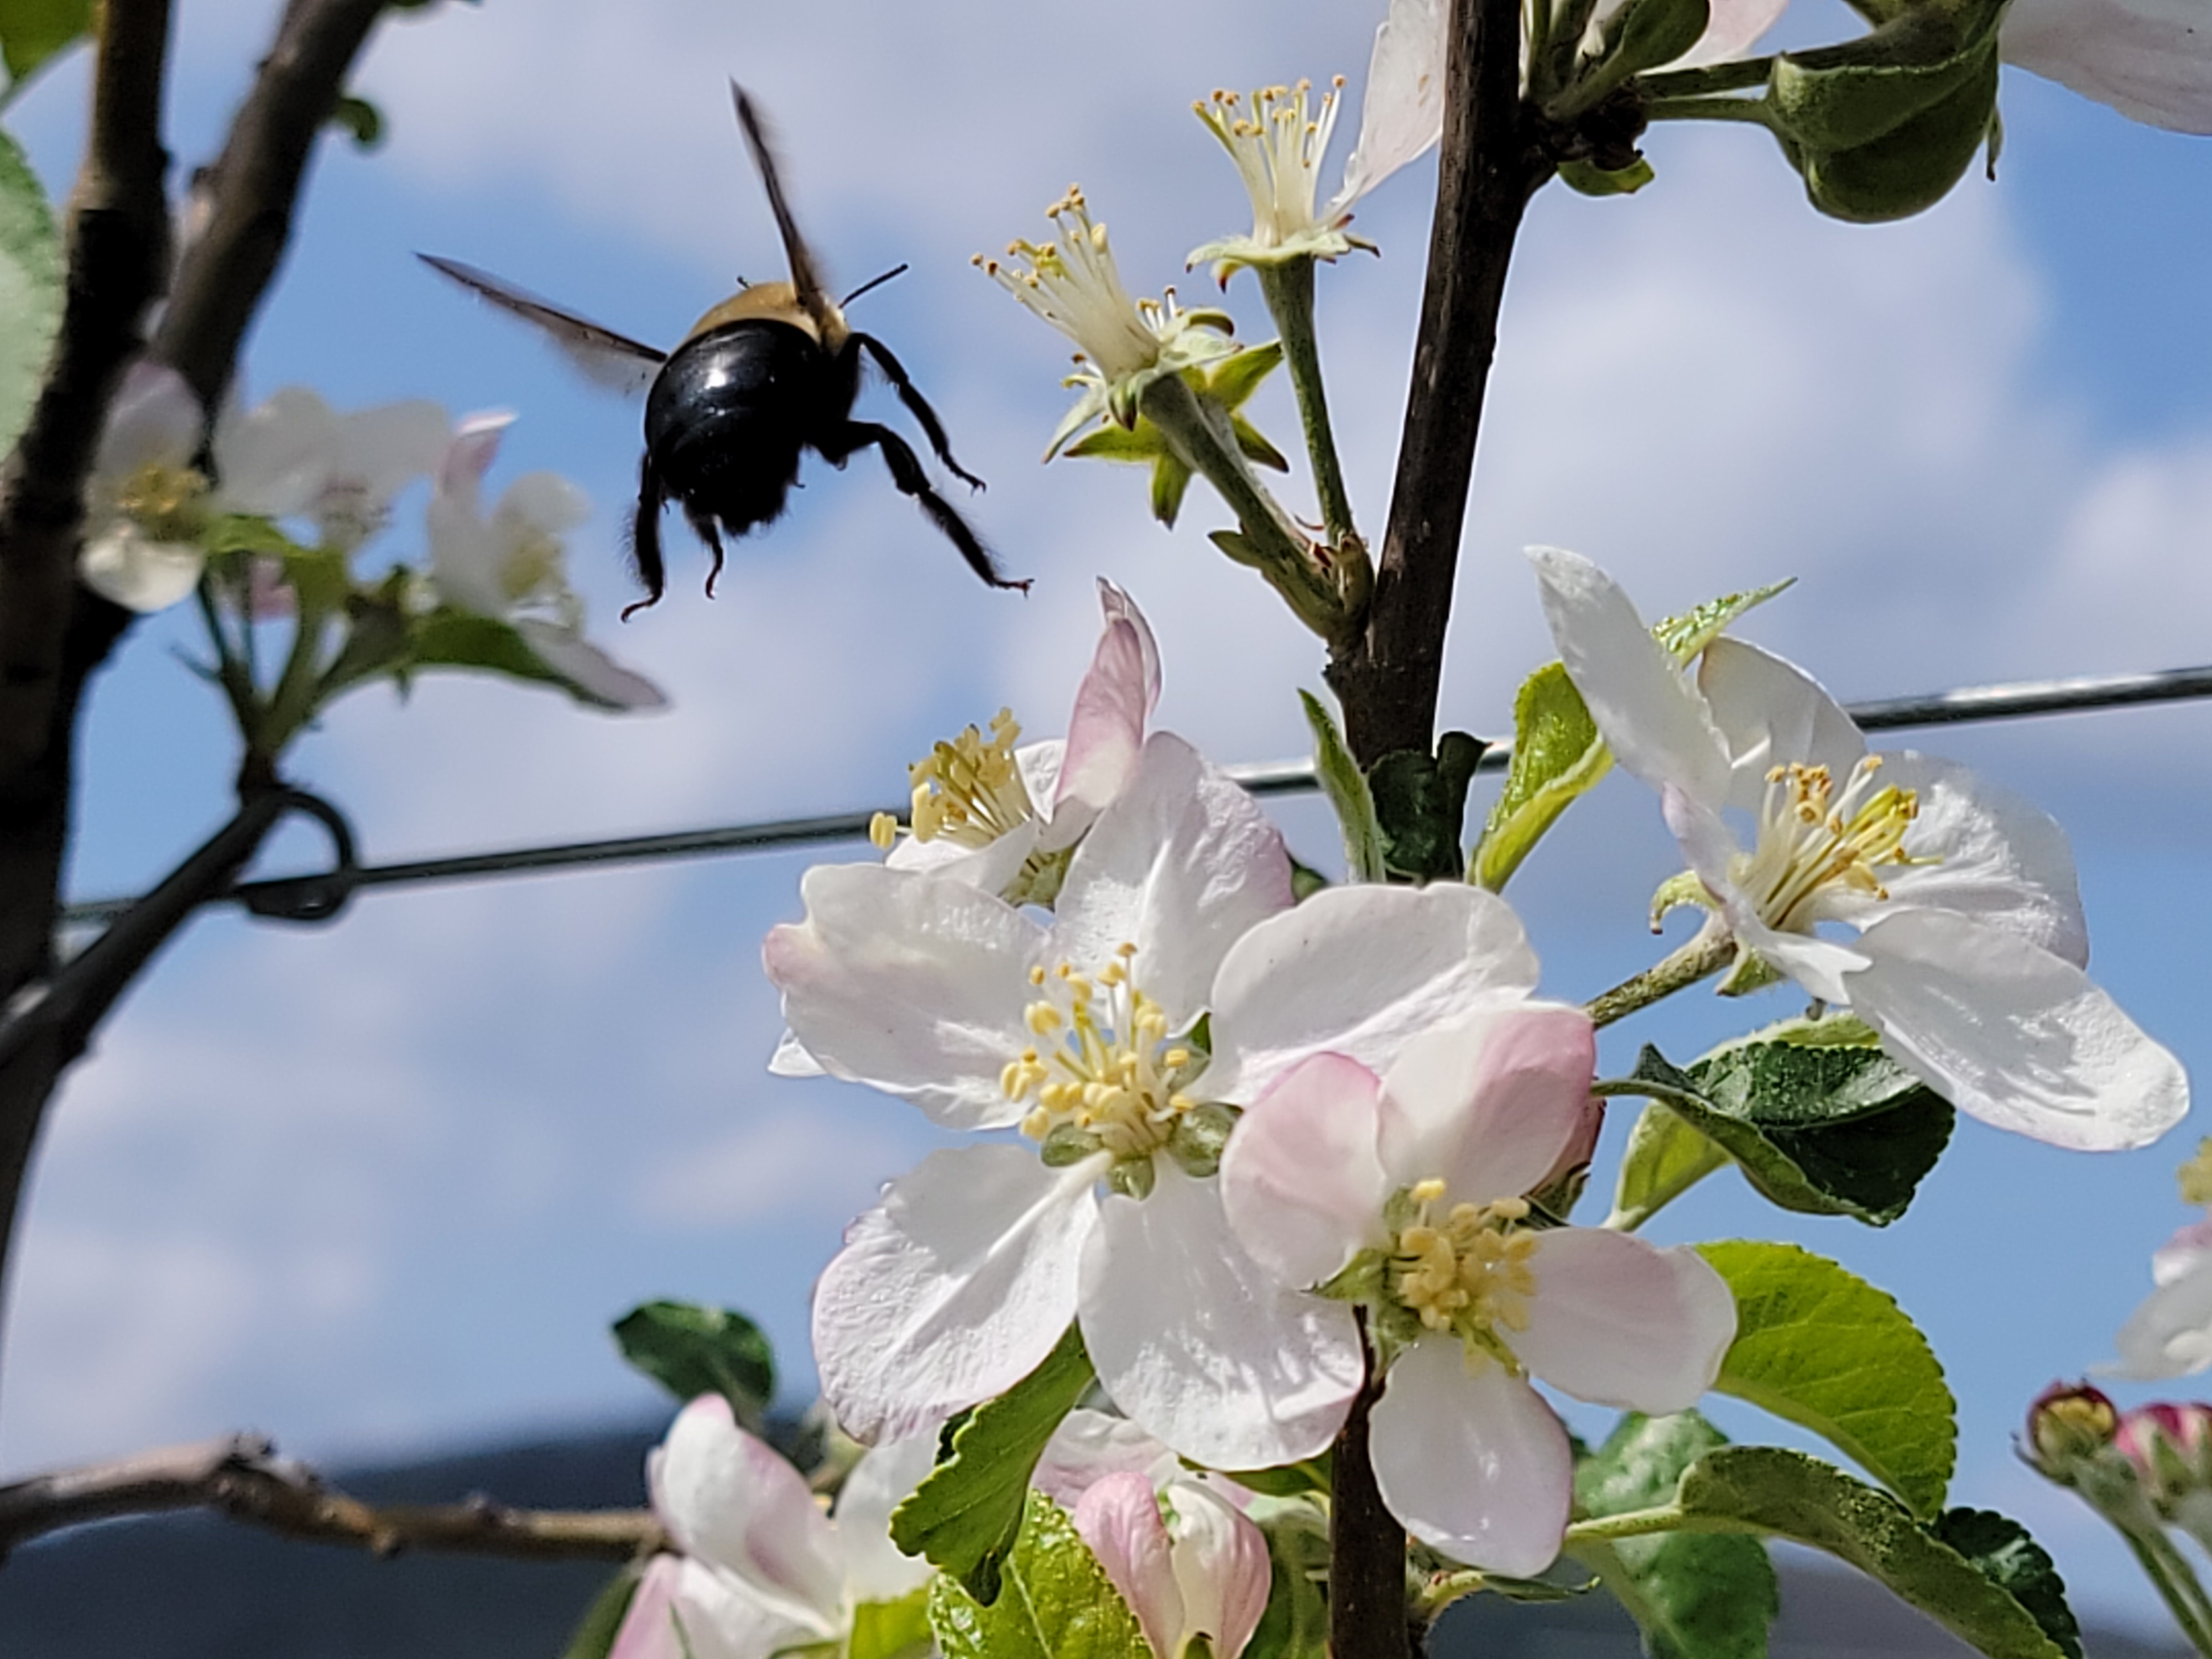
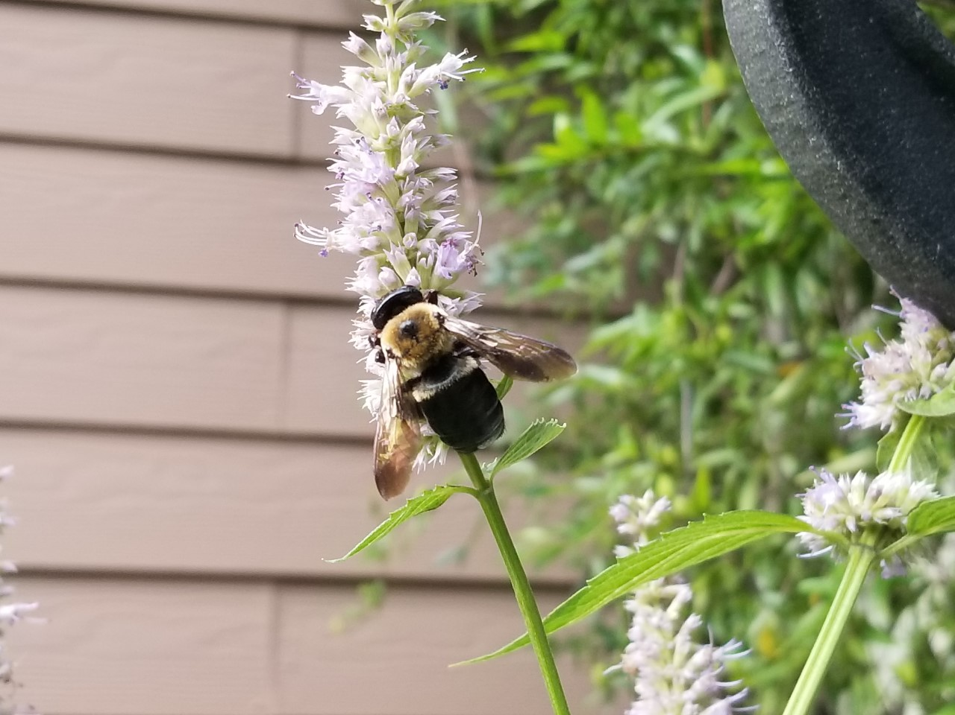
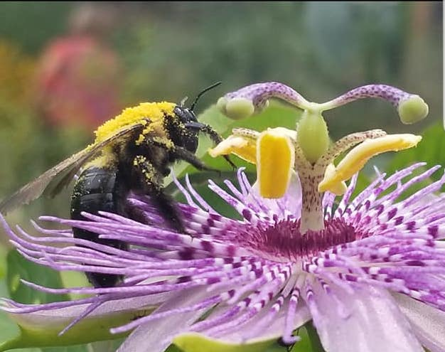
Eastern Carpenter Bee
(Xylocopa virginica)
Notes:
Things to notice in this slide. Notice the very slick and hairless abdomen. The top slide where the bee has a yellow or white mark on the face, that is a male carpenter bee. The yellow mark is only on the male bees, which do NOT have stingers. Also notice all of the pollen on the top of the bee’s thorax. They are excellent pollinators, they are out early in the spring and are one of the last ones to finish their lifecycle in the fall.

Slide 7
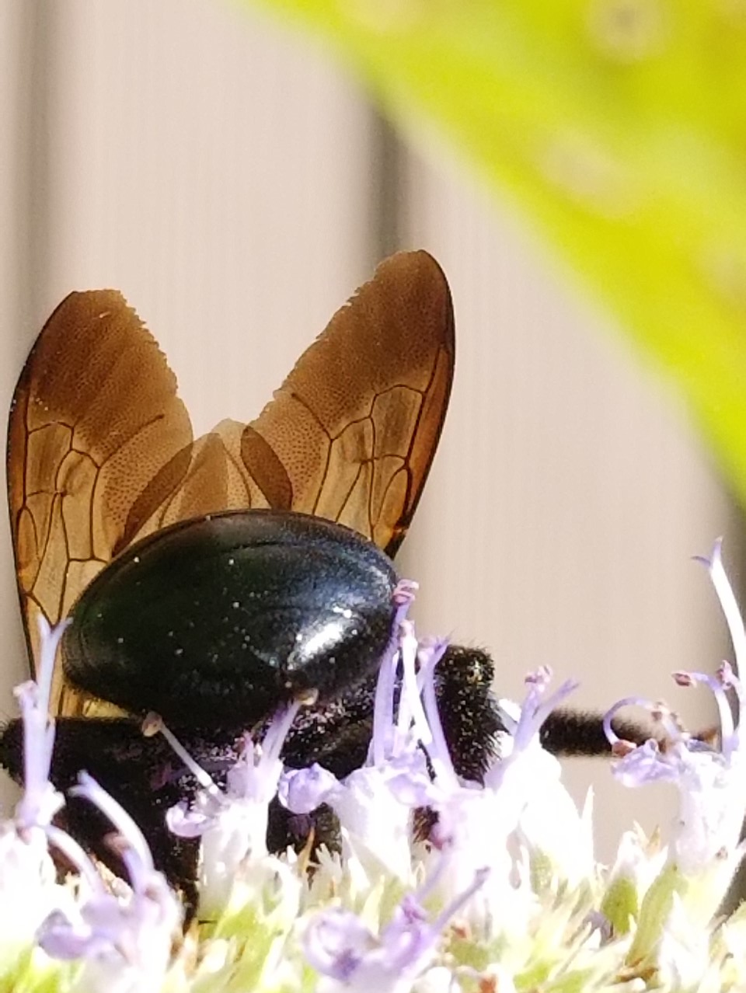
Carpenter Bees
(16 – 22 mm)
Black body with yellow and black bands
Dense hair on head and thorax
NO HAIR on abdomen
Broad head, thick body
Males have yellow to white coloring on face, females all black on face
Notes:
Carpenter bees have bald abdomens so they have “shiny heinies”

Slide 8
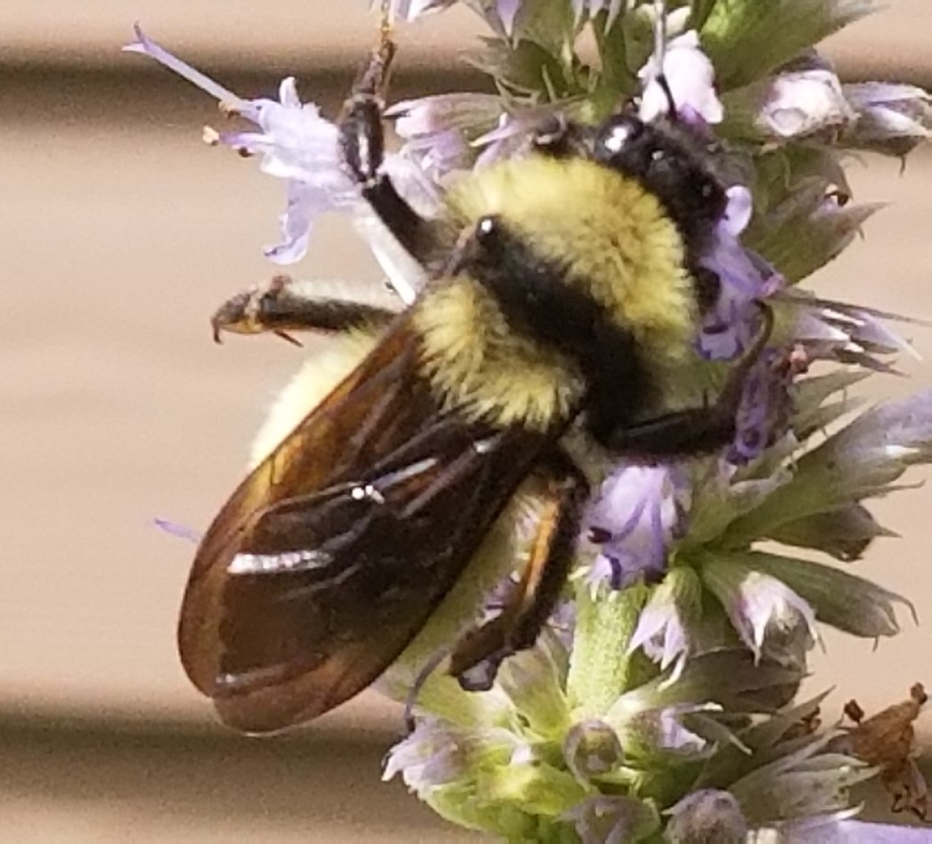
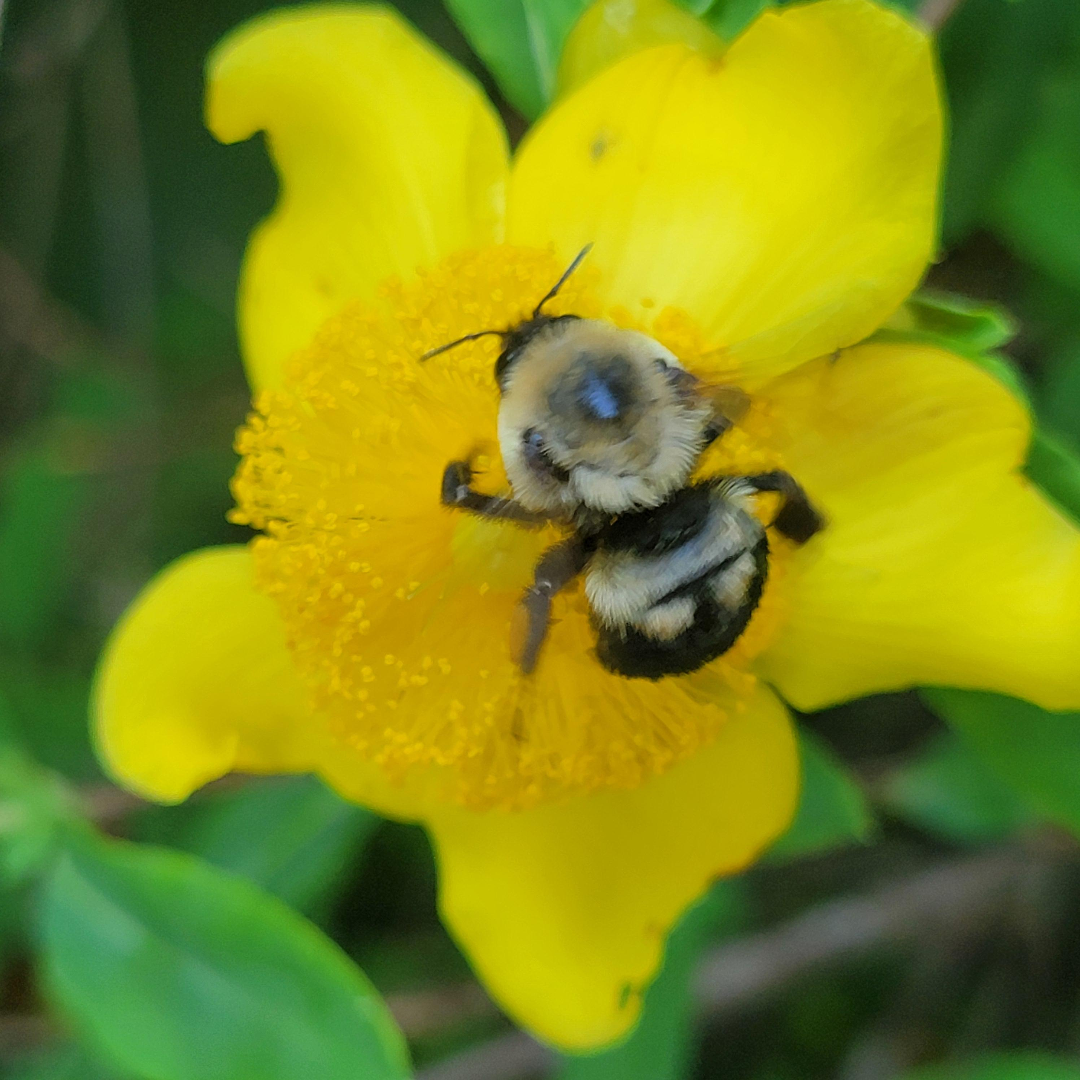
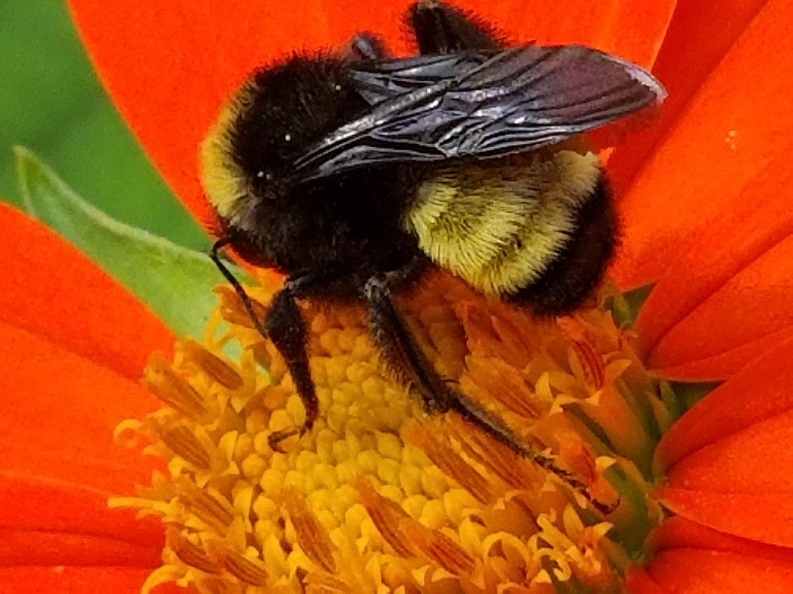
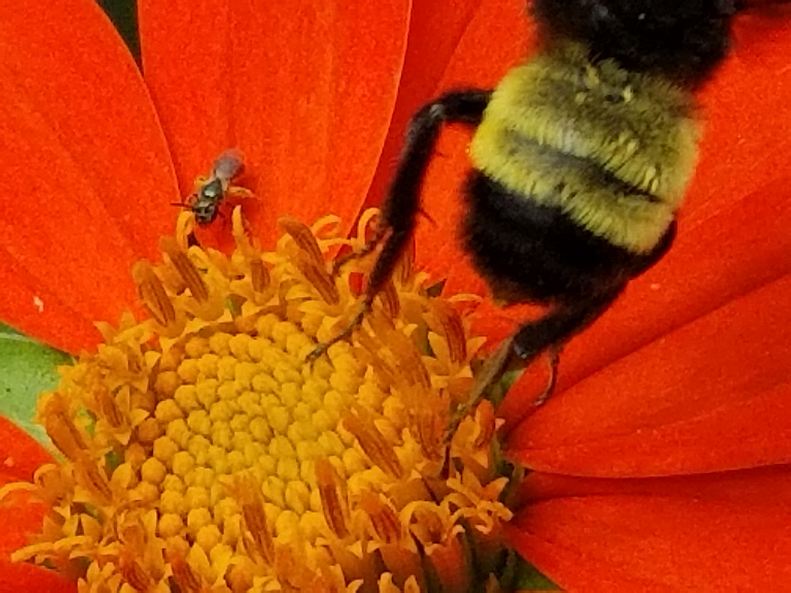
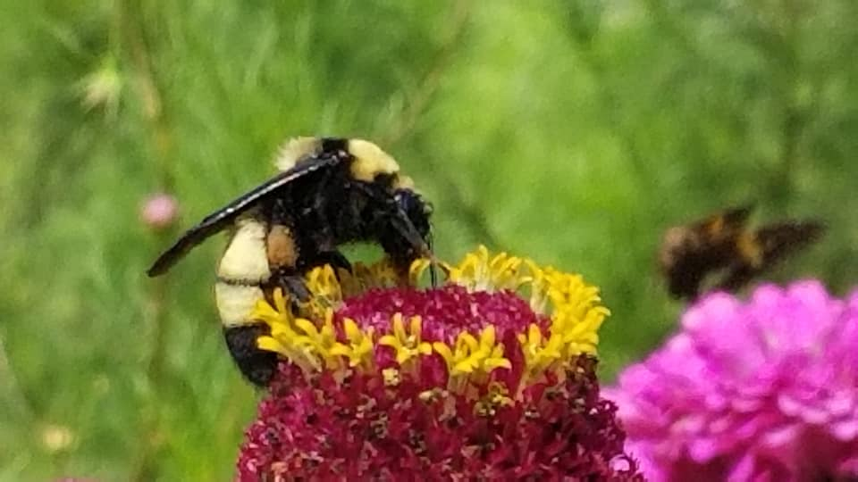
Bumble bee (Bombus spp.)
Notes:
Bumble bees have hairy abdomens “fuzzy rear”

Slide 9
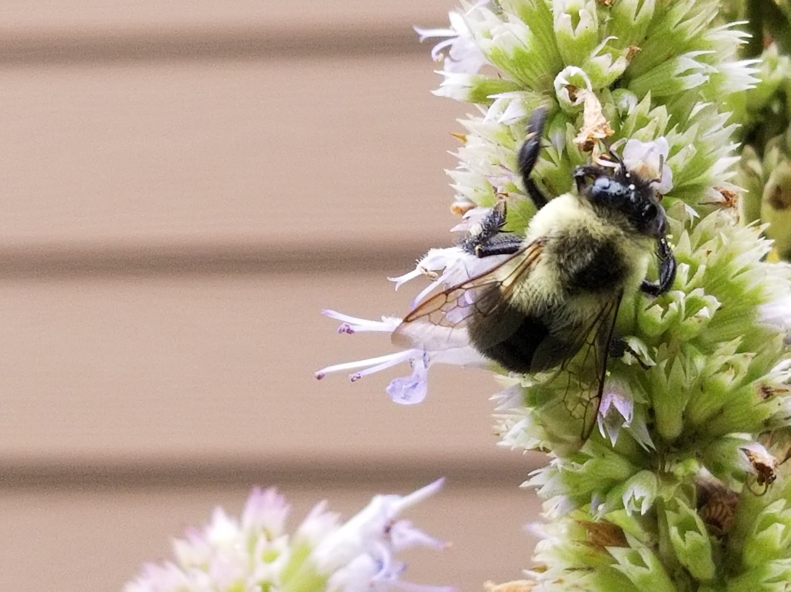
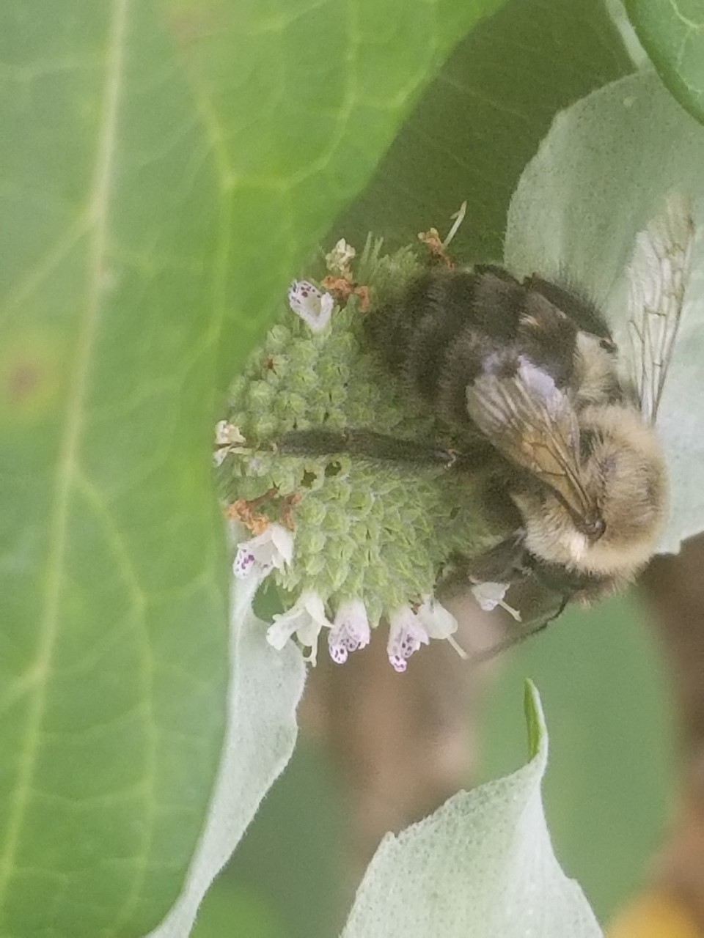
Bumble Bees
(10 – 19 mm)
Black body covered with dense yellow and black hair
Fat bee with small head
Large thorax and abdomen
Hairy abdomen

Slide 10
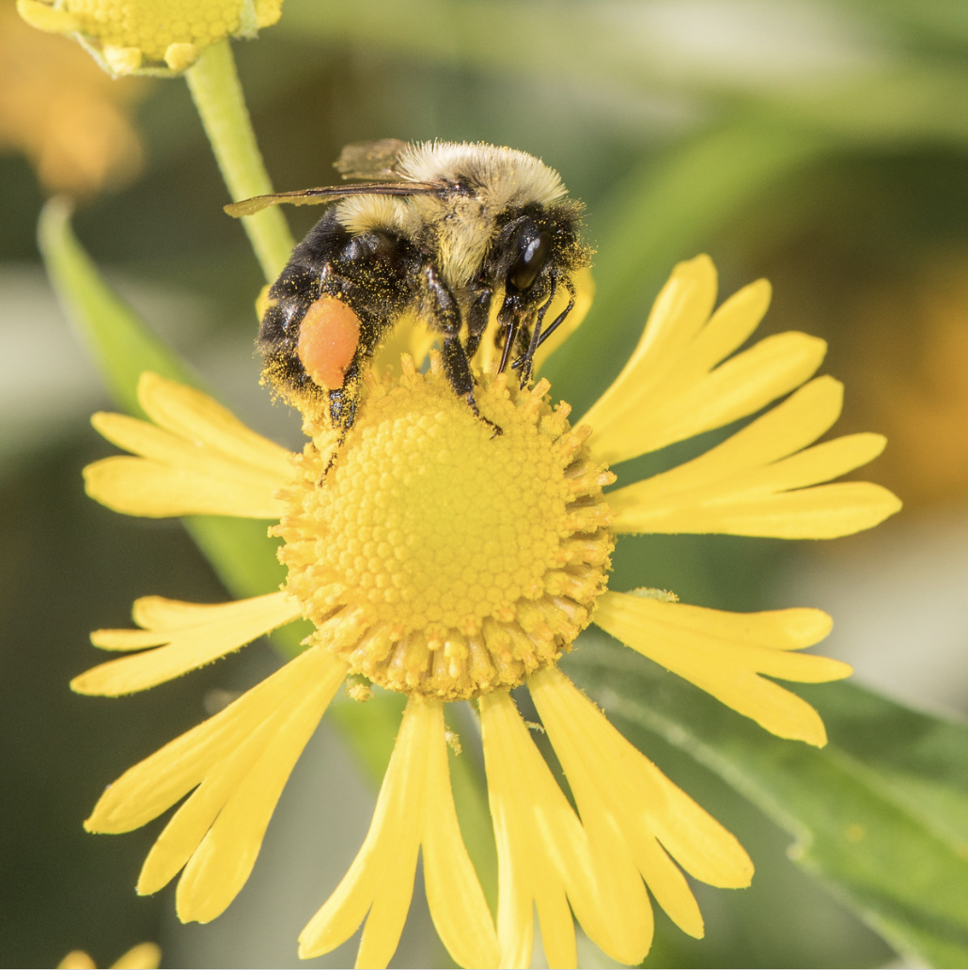
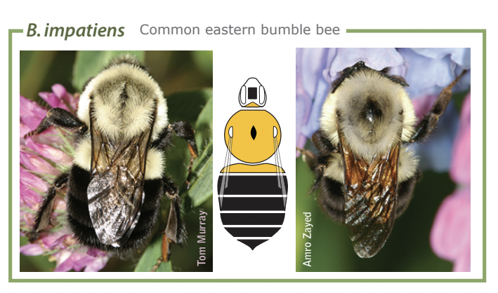
Bombus impatiens – Eastern Bumble Bee
Most common bumble bee in the Southeast
Long-tongued bees
Notice that bumble bees are covered in hair
Photo by Heather Holms
Diagram from beespotter.org

Slide 11
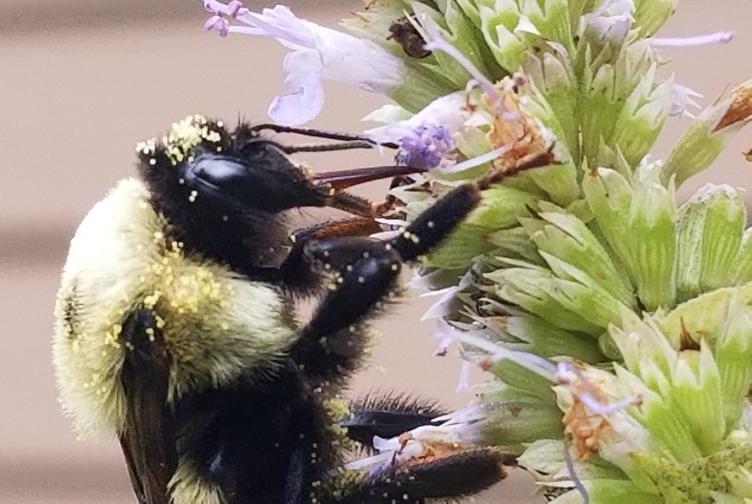
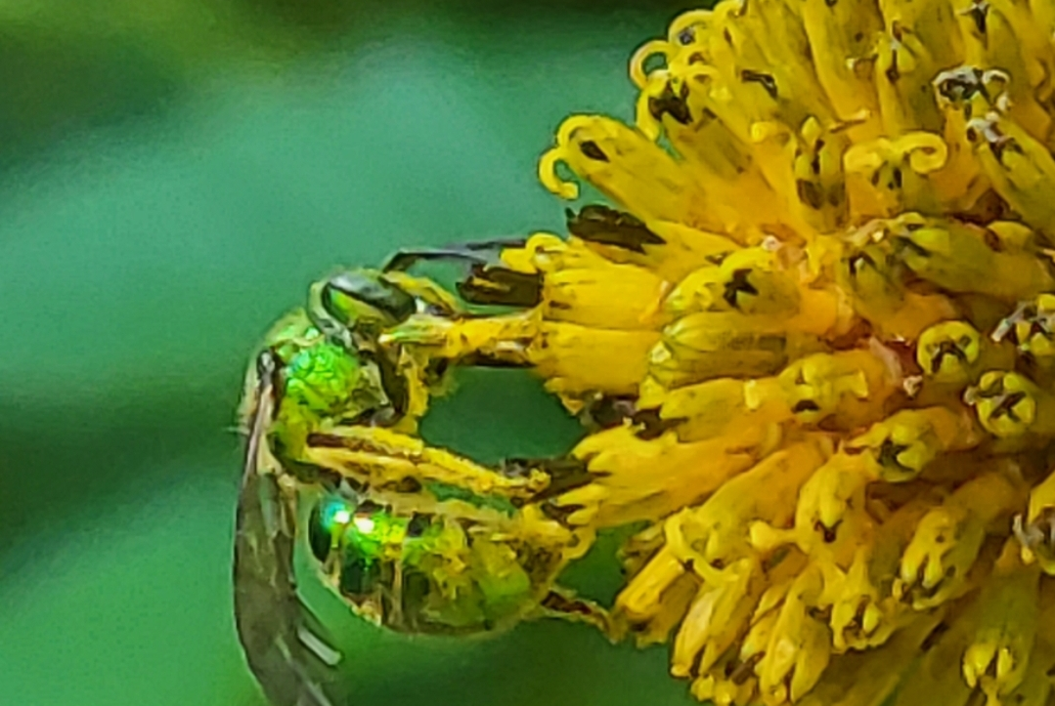
Pile (bee hair)
Notes:
Bumble bee hair (pile) is perfect for moving pollen around. Notice all the pollen on the bumble bee and the lack of hair and pollen on the green metallic bee.

Slide 12
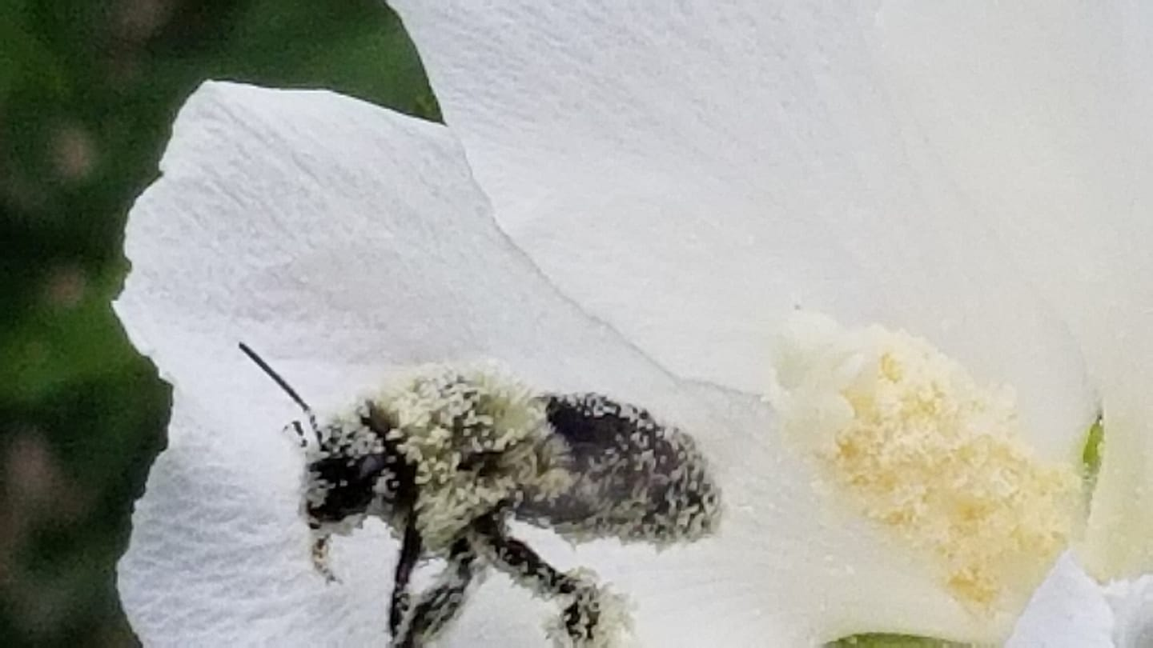
Notes:
Again notice how the bee hair (pile) holds all the pollen

Slide 13
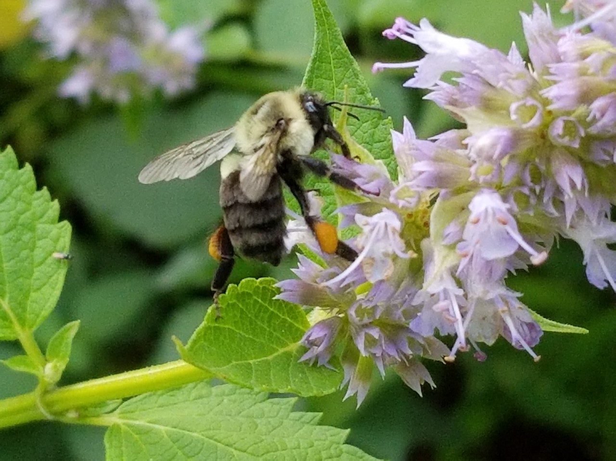
Corbicula (Corbiculae) – pollen basket
Photo:Becky Griffin
Notes:
As bumble bees gather pollen they groom themselves moving the pollen into pollen baskets called corbiculae. Bumble bee queens have a need for pollen for themselves and their young. Corbiculae assist them in taking as much pollen as possible back to their nest. However, pollen nicely tucked into the pollen baskets is not available for pollinating flowers.

Slide 14
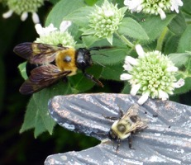
This photo illustrates the differences between the
carpenter bee and a bumble bee. The carpenter bee is a “mack truck” while the bumble bee is more of a “pickup truck.” Thank you, Bodie Pennisi for the photo!

Slide 15
Question #1
Is this a carpenter bee or a bumble bee?
Carpenter Bee
Bumble Bee
Notes:
Carpenter Bee

Slide 16
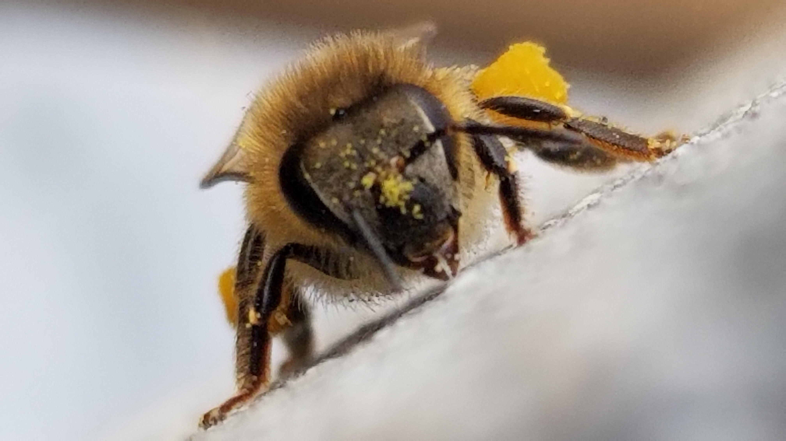
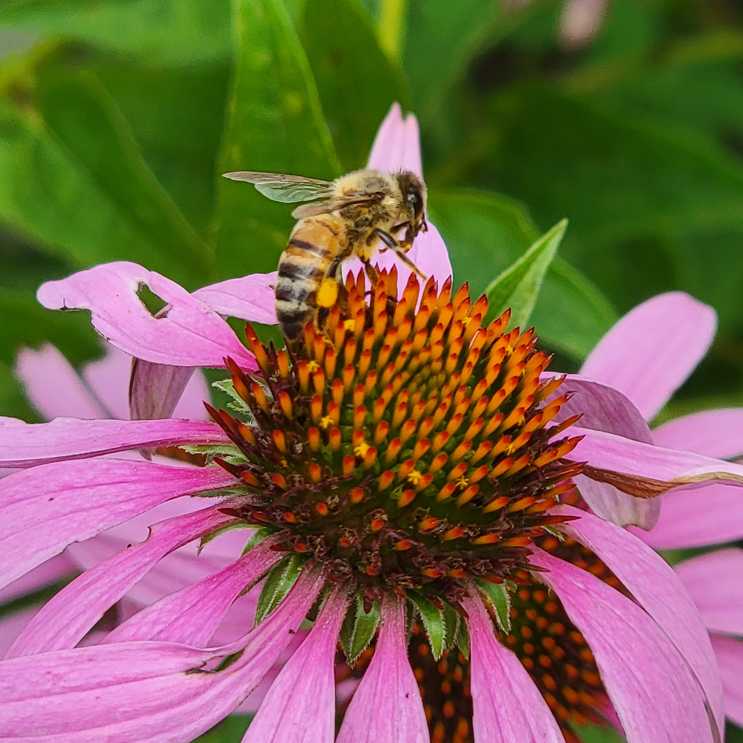
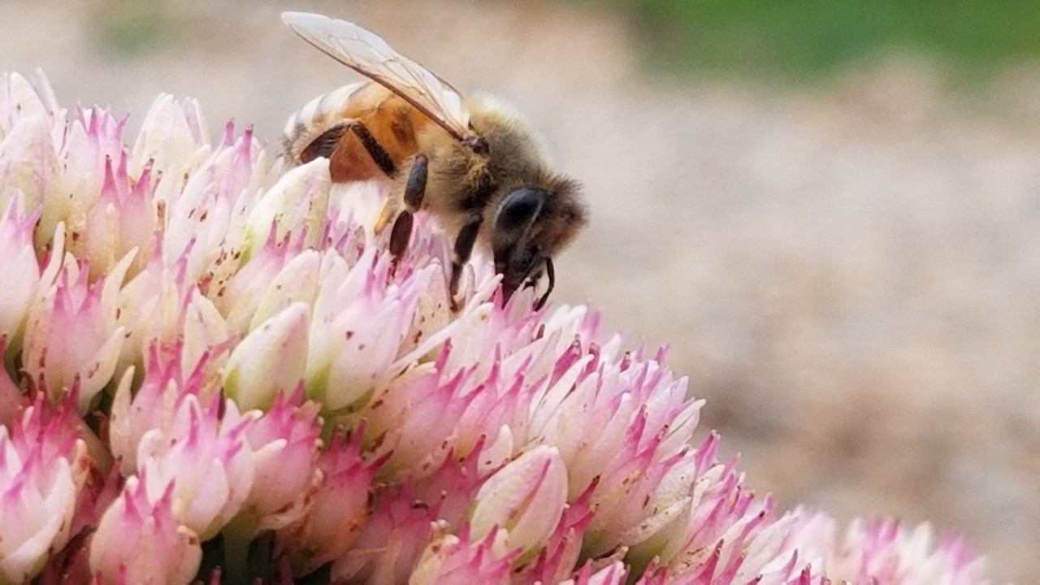
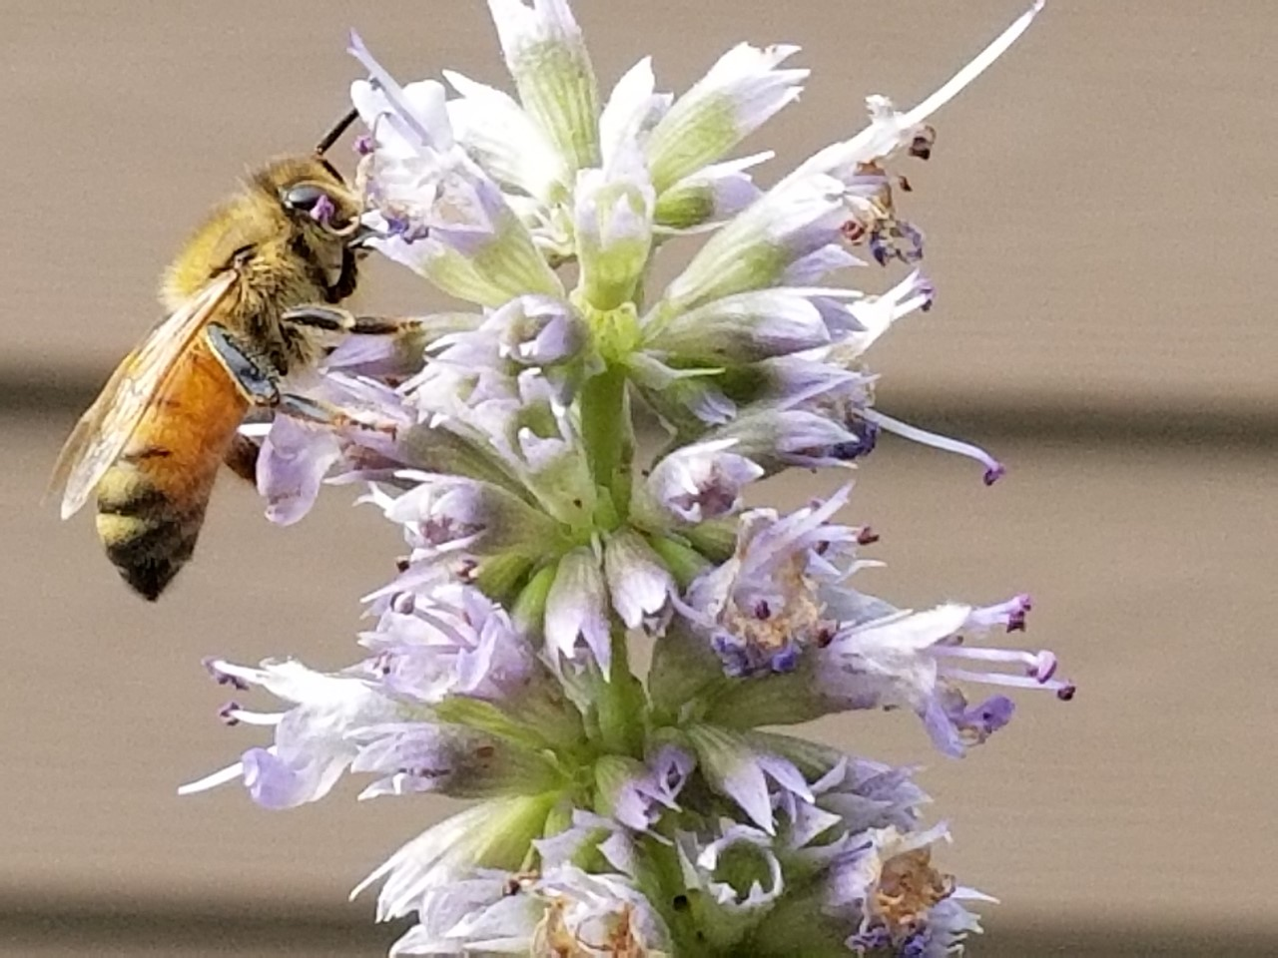
Honey Bees
(12 – 15 mm)
Brown or black stripes on body
Golden-brown hair covers abdomen
Notes:
Honey bees also have corbiculae or pollen baskets to carry pollen back to their hives. Notice the mandibles on the top image. These are used to shape wax for their hives.

Slide 17
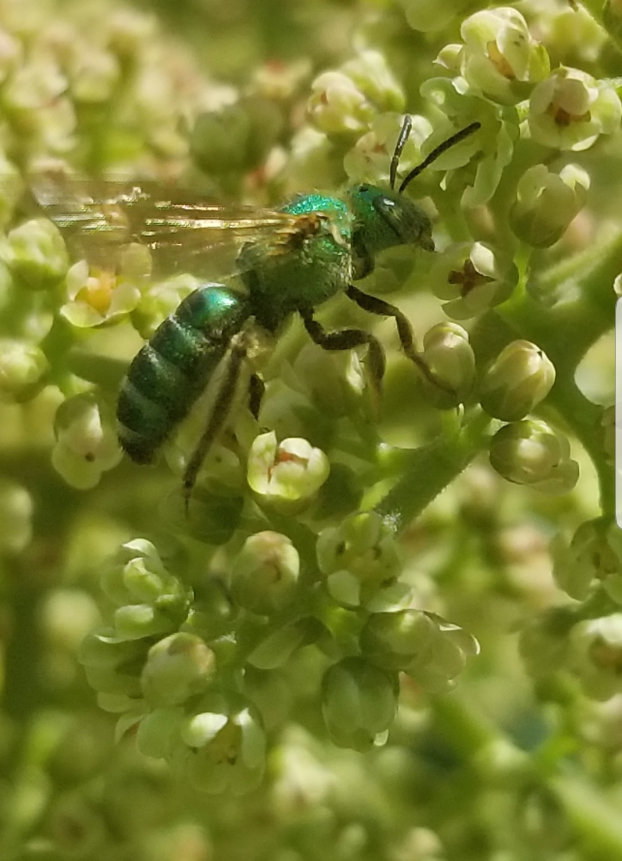
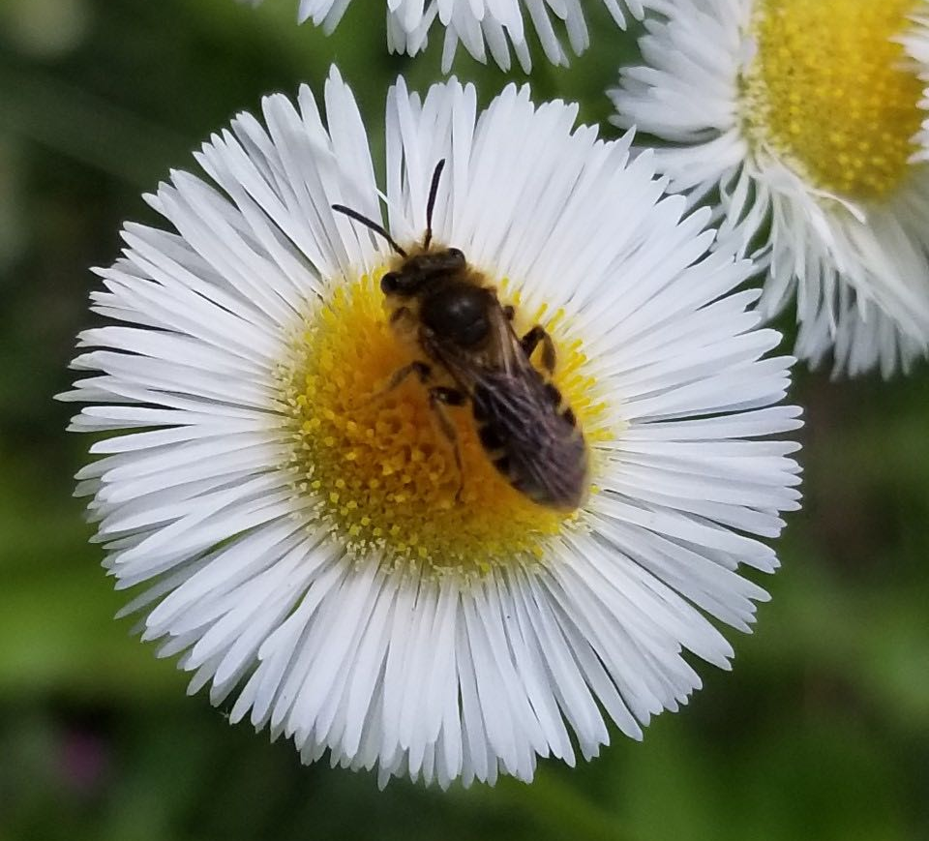
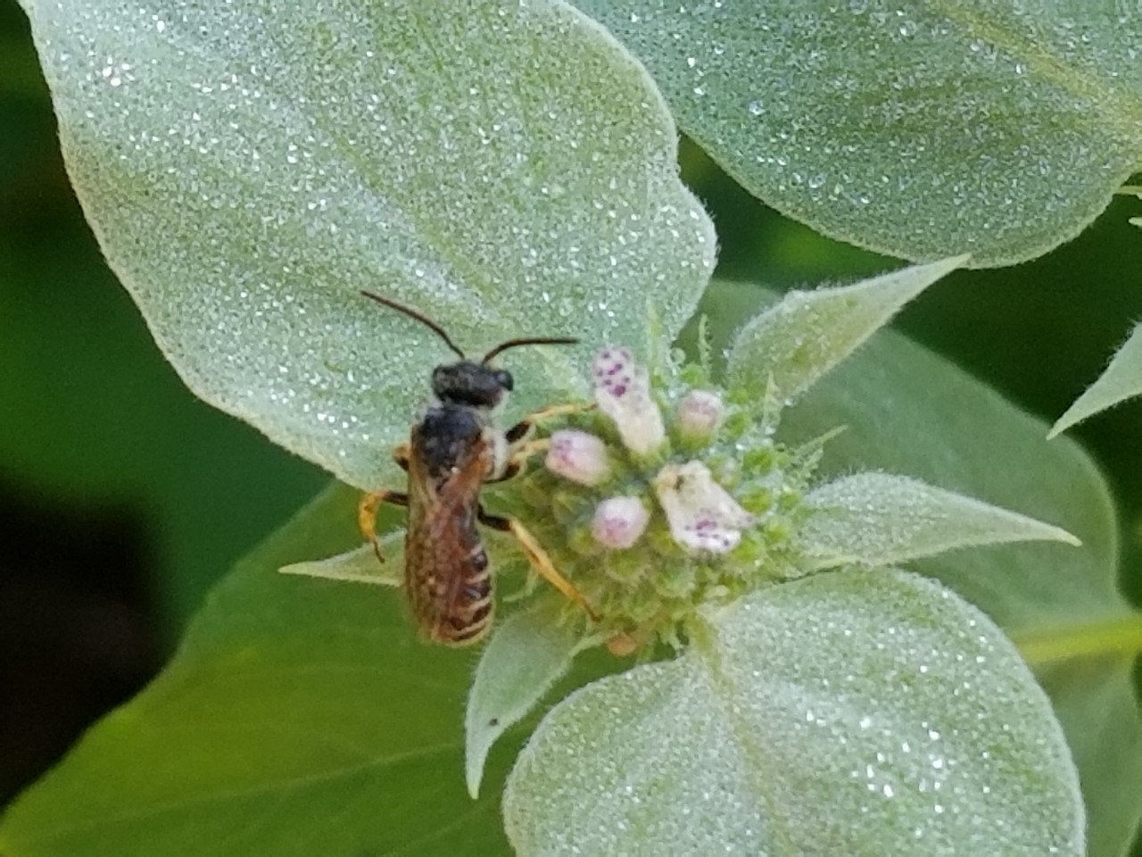
Small Bees
(Any bee smaller than a honey bee <12 mm)
Can include:
Leafcutter Bees
Sweat Bees
And others

Slide 18
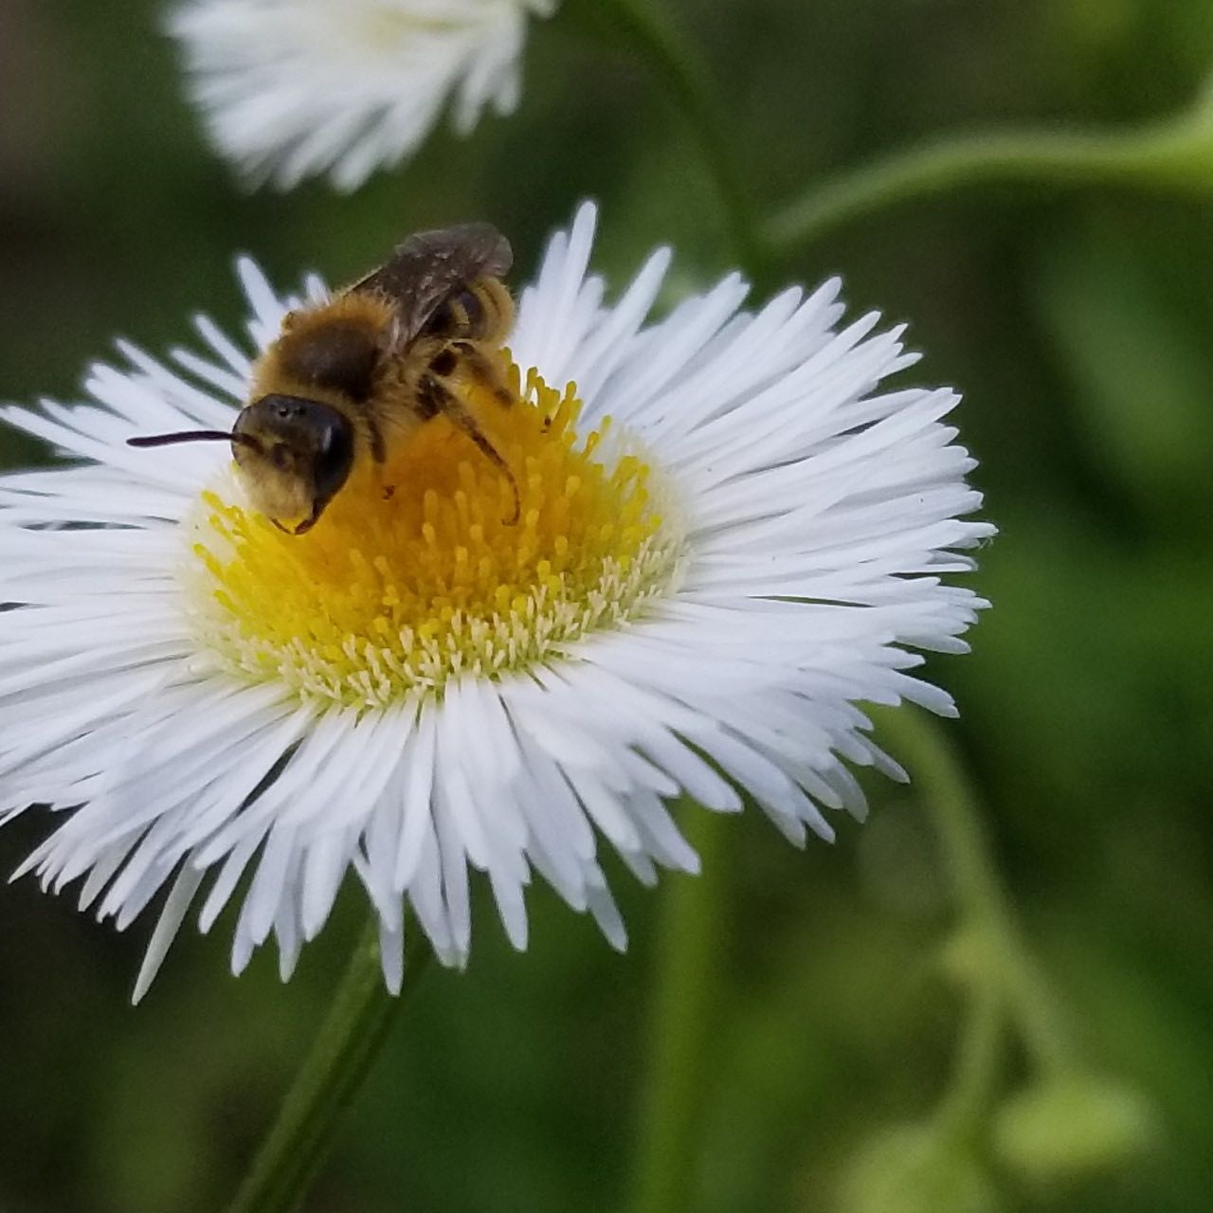
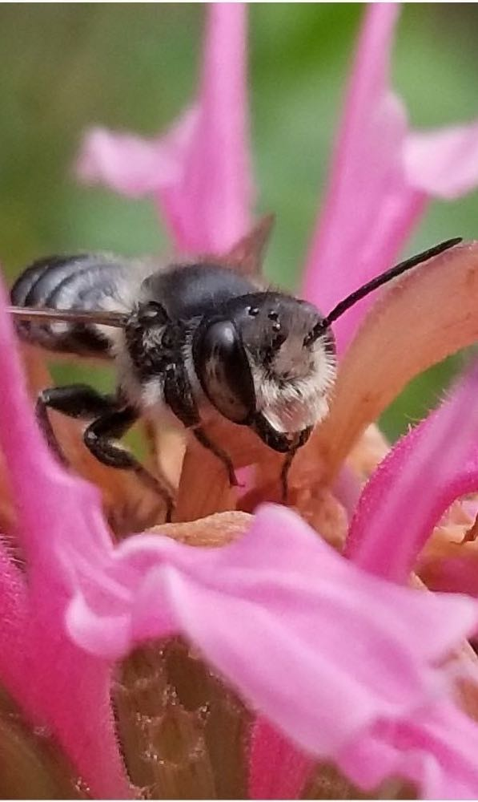
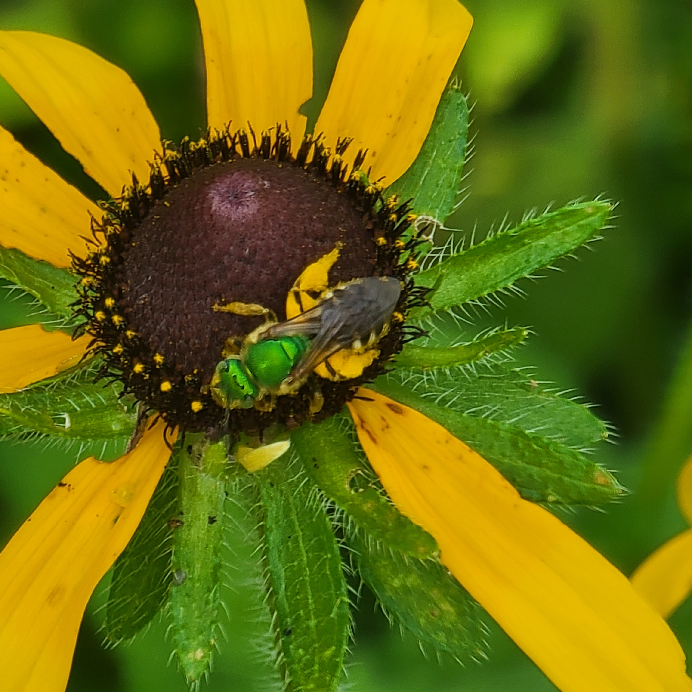
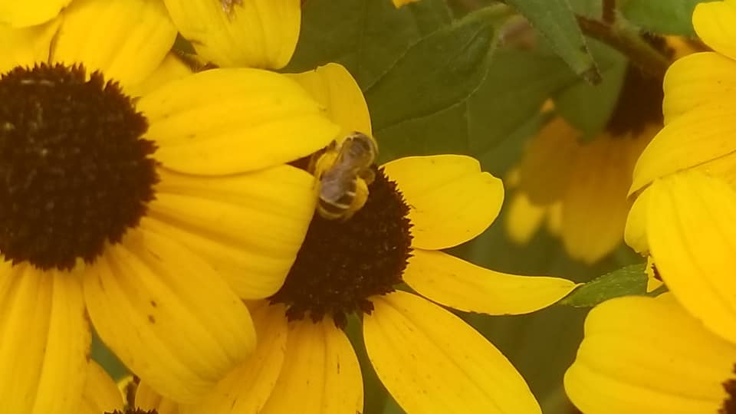
Small bees
Notes:
All of these bees are smaller than honey bees and are all seen during the pollinator census. The bee on the pink flower is a leaf cutter bee. These are all over the Southeast and you will see them during the Census.

Slide 19
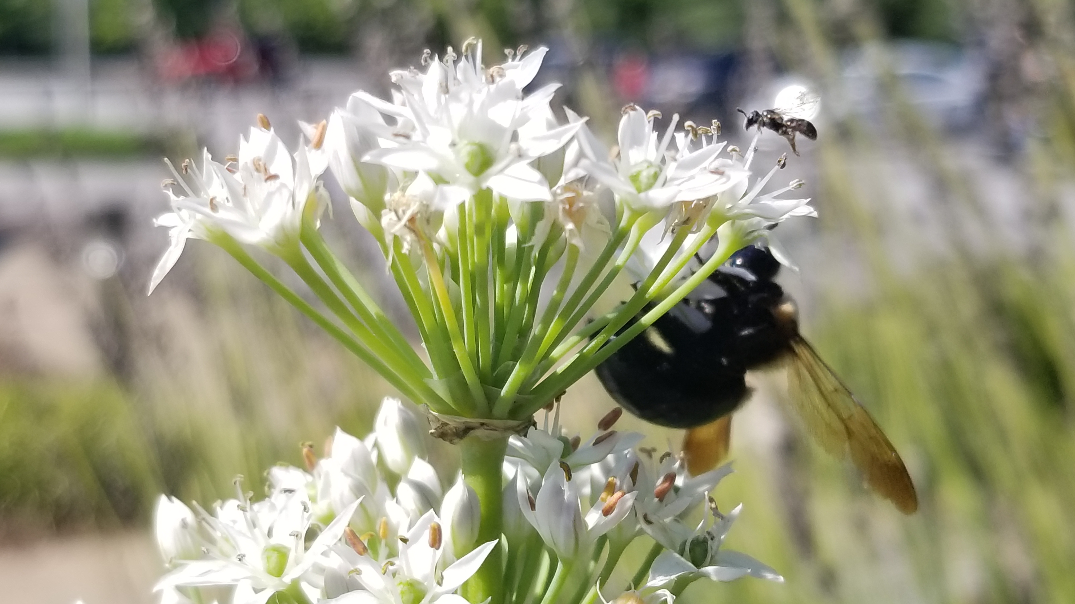
Honey Bee
Notes:
This photo has a small bee and a carpenter bee

Slide 20
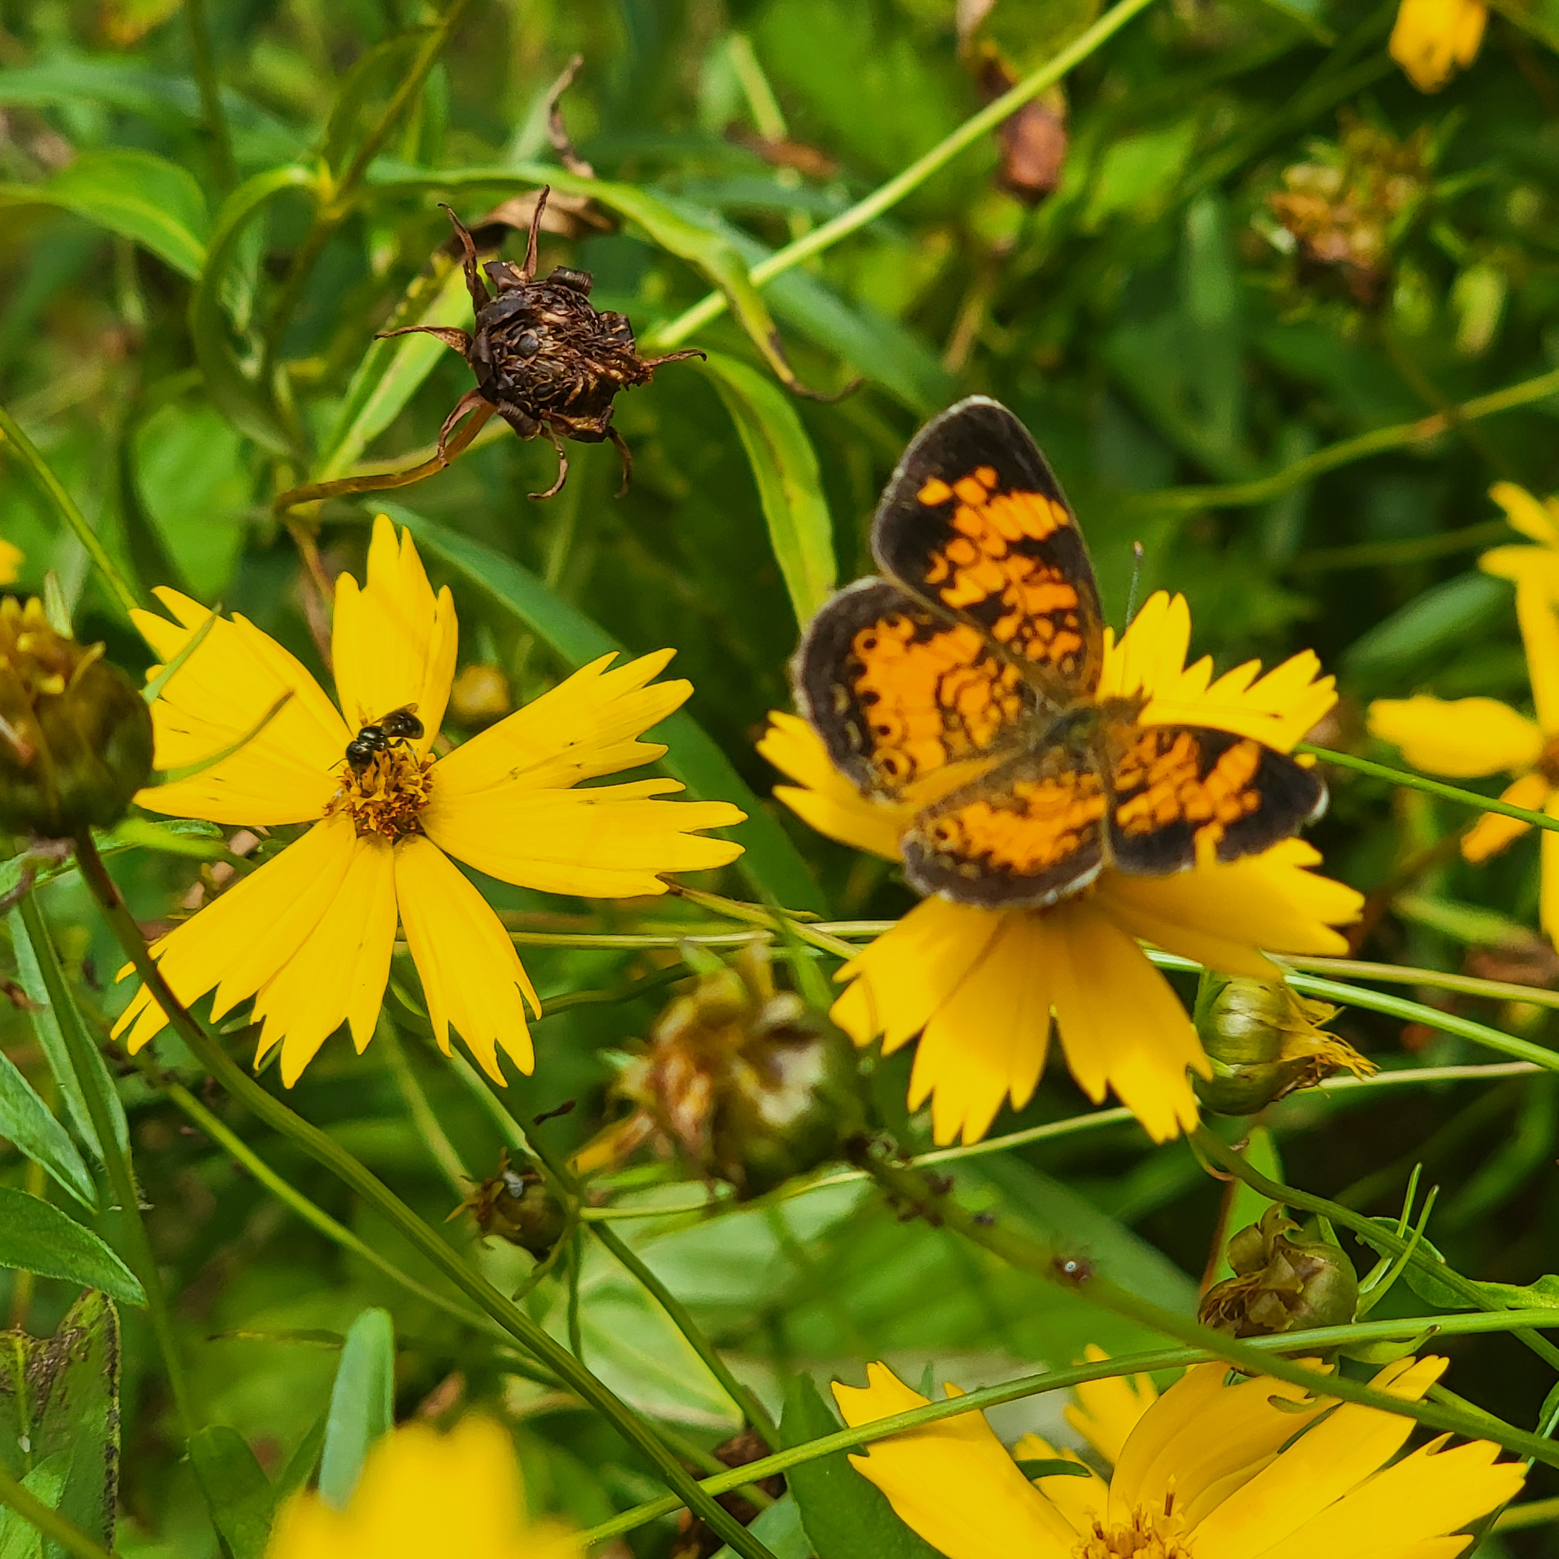
Notes:
This photo has a small bee and a butterfly

Slide 21
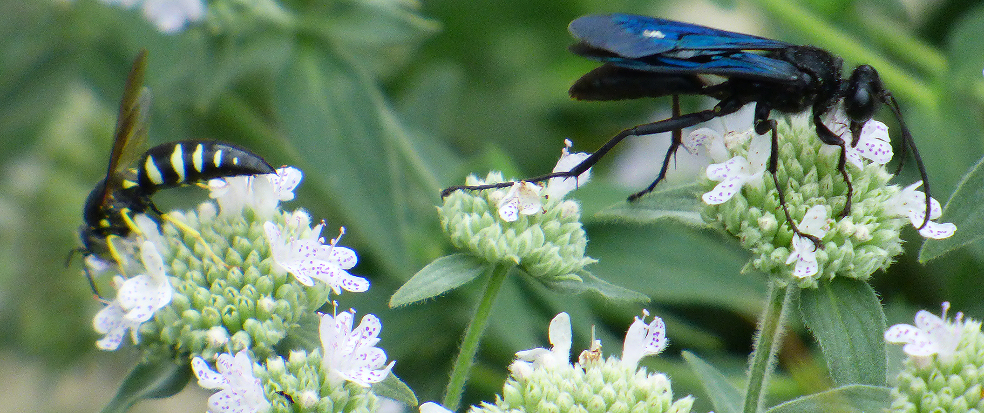
Wasps

Slide 22
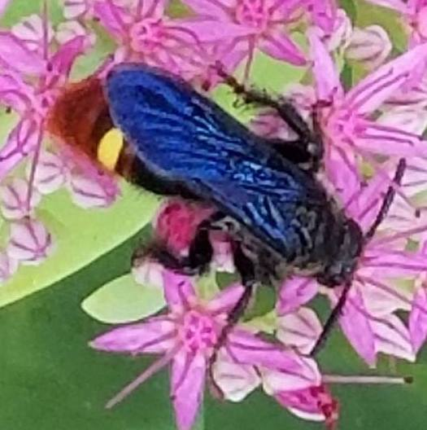
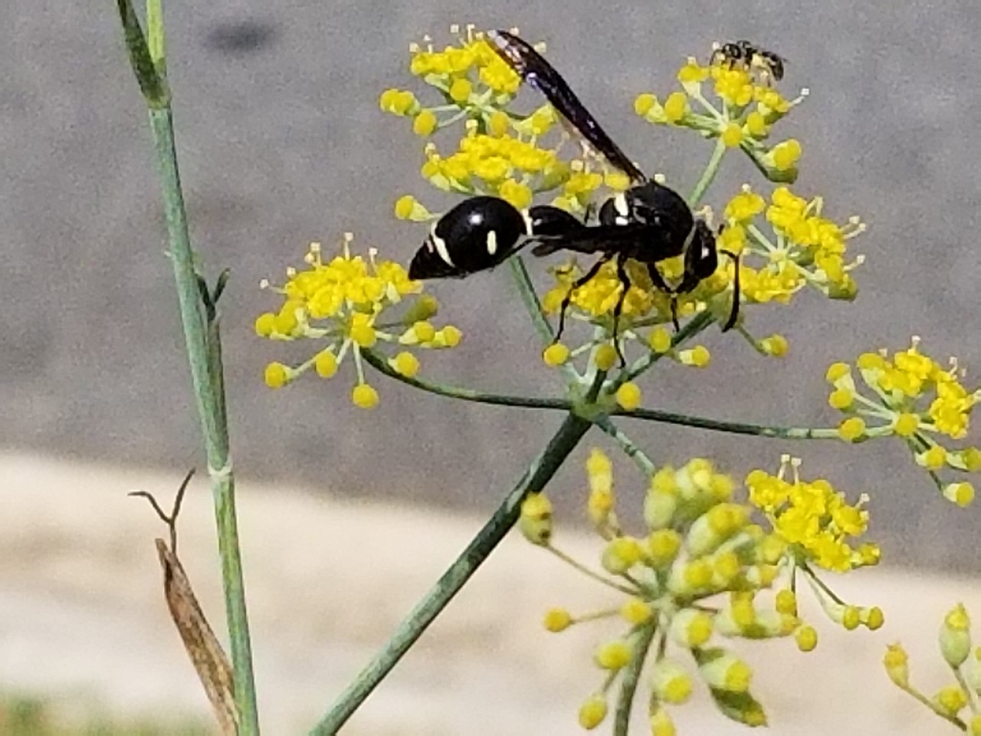
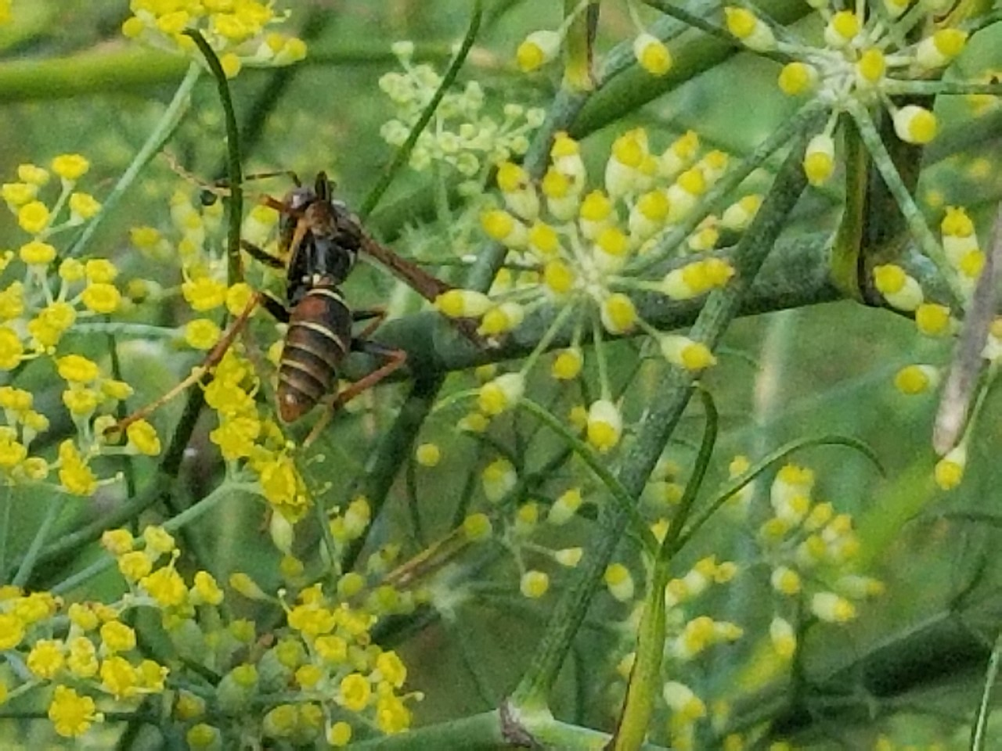
Wasps
(13 - 25 mm)
Can include:
Potter Wasps
Paper Wasps
And others
These are generally hairless. Some have very narrow waists.
Potter Wasp
Scoliid Wasp
Paper Wasp

Slide 23
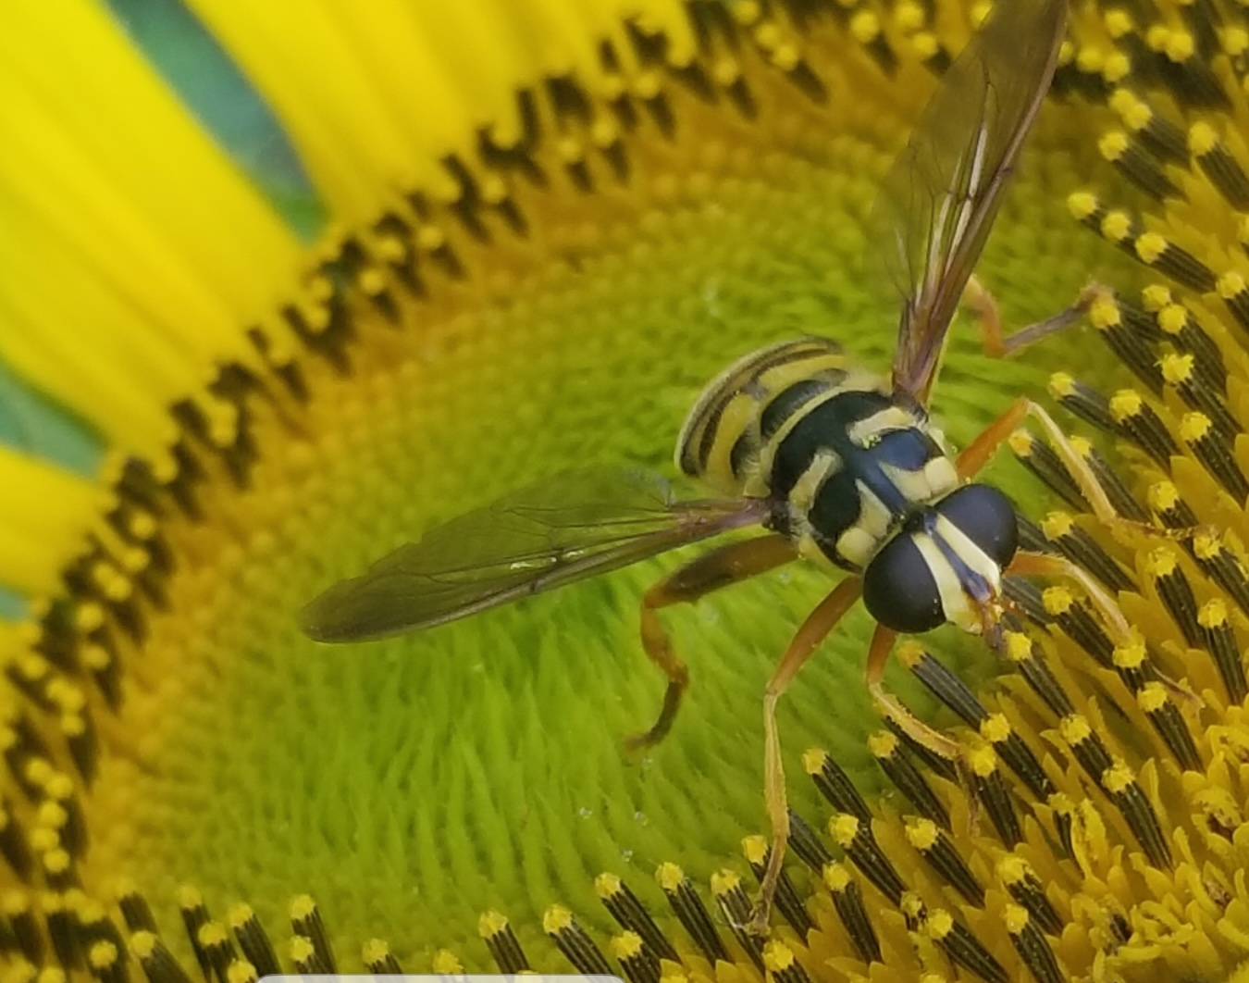
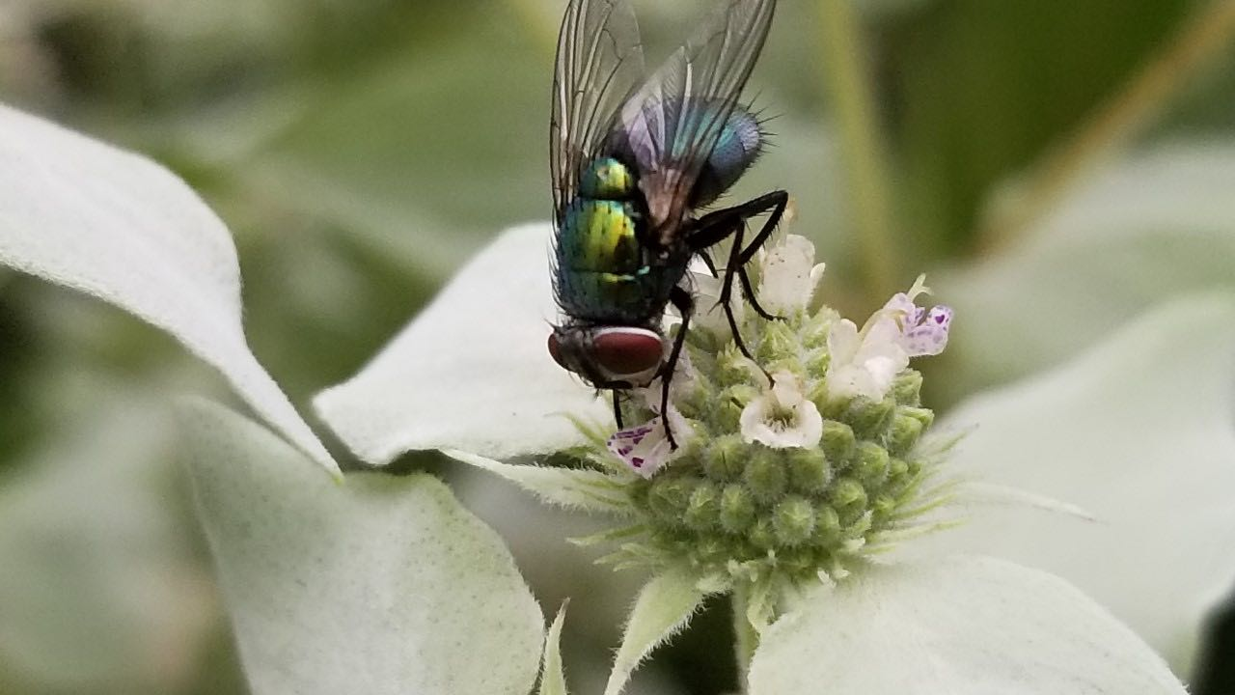
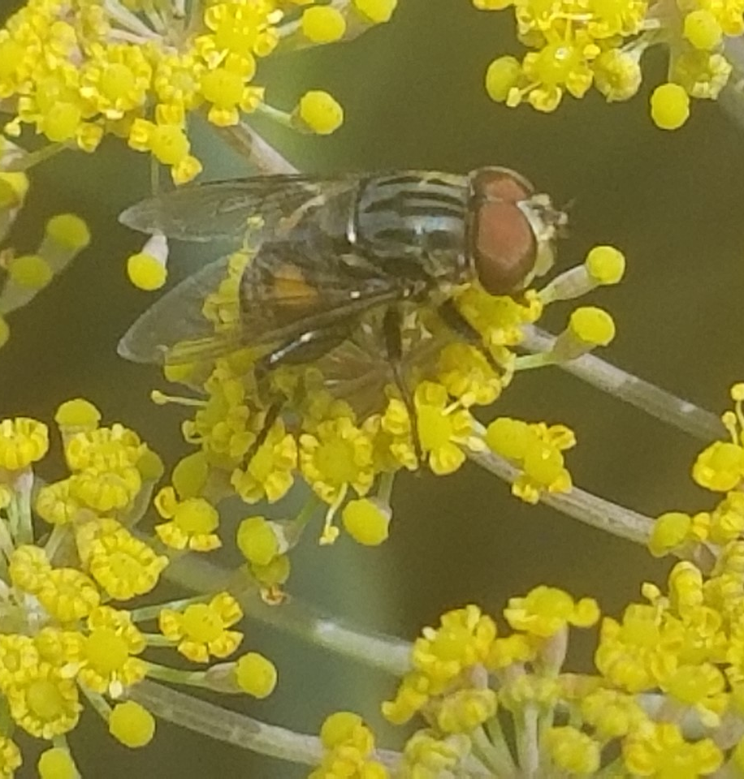
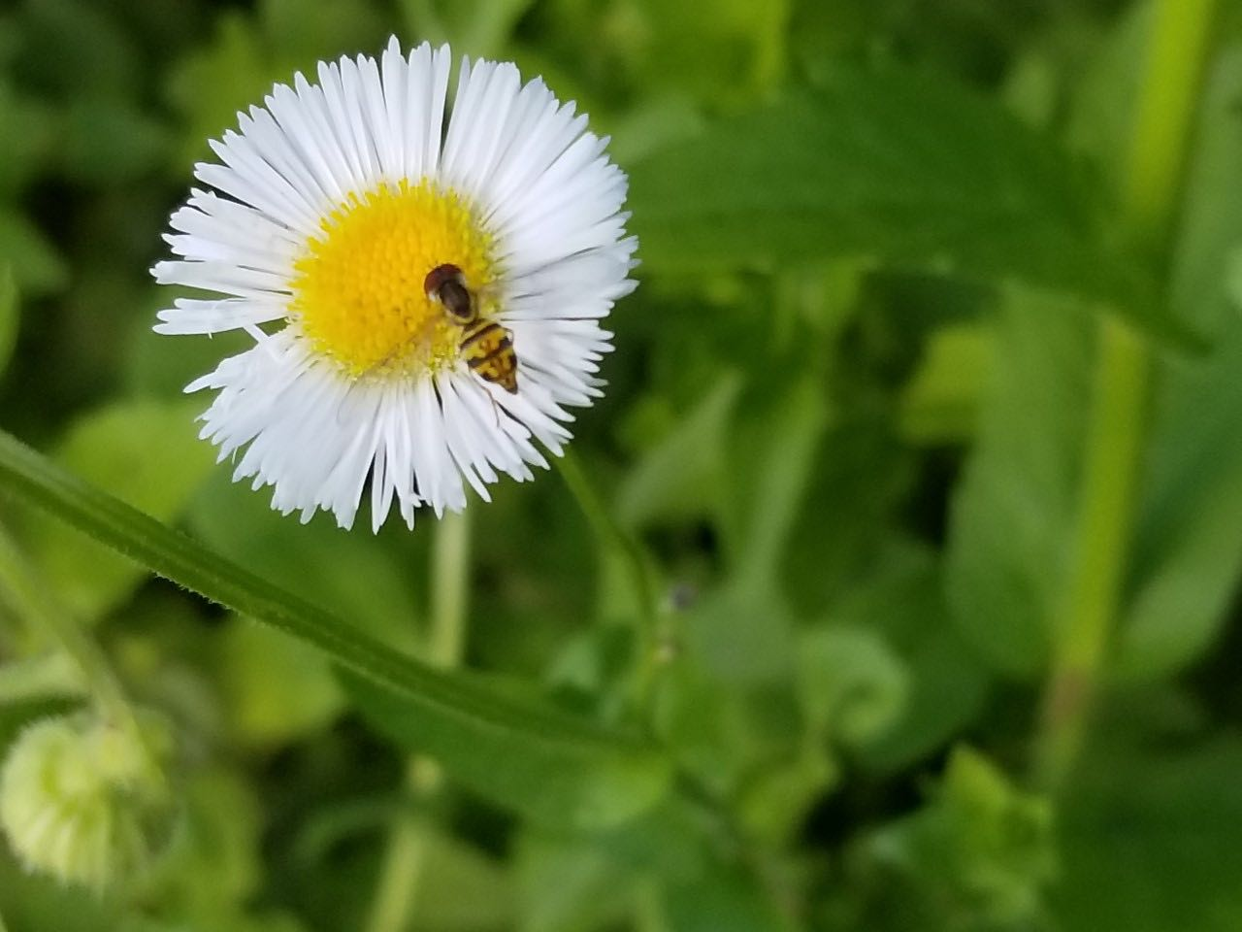
Oh my, it’s a
FLY!
Notes:
These are all flies that you may see during the Census

Slide 24
Comparing bees with flies
Bees
Flies
Have four wings
Have prominent antennae
Have two large eyes and three smaller ones in between (ocelli)
Carry pollen in pollen baskets (corbicula) or scopa (on underside of abdomen)
Are generally hairy
Have two wings
Have smaller antennae
Have two prominent eyes
Do not carry pollen
Are generally not very hairy

Slide 25
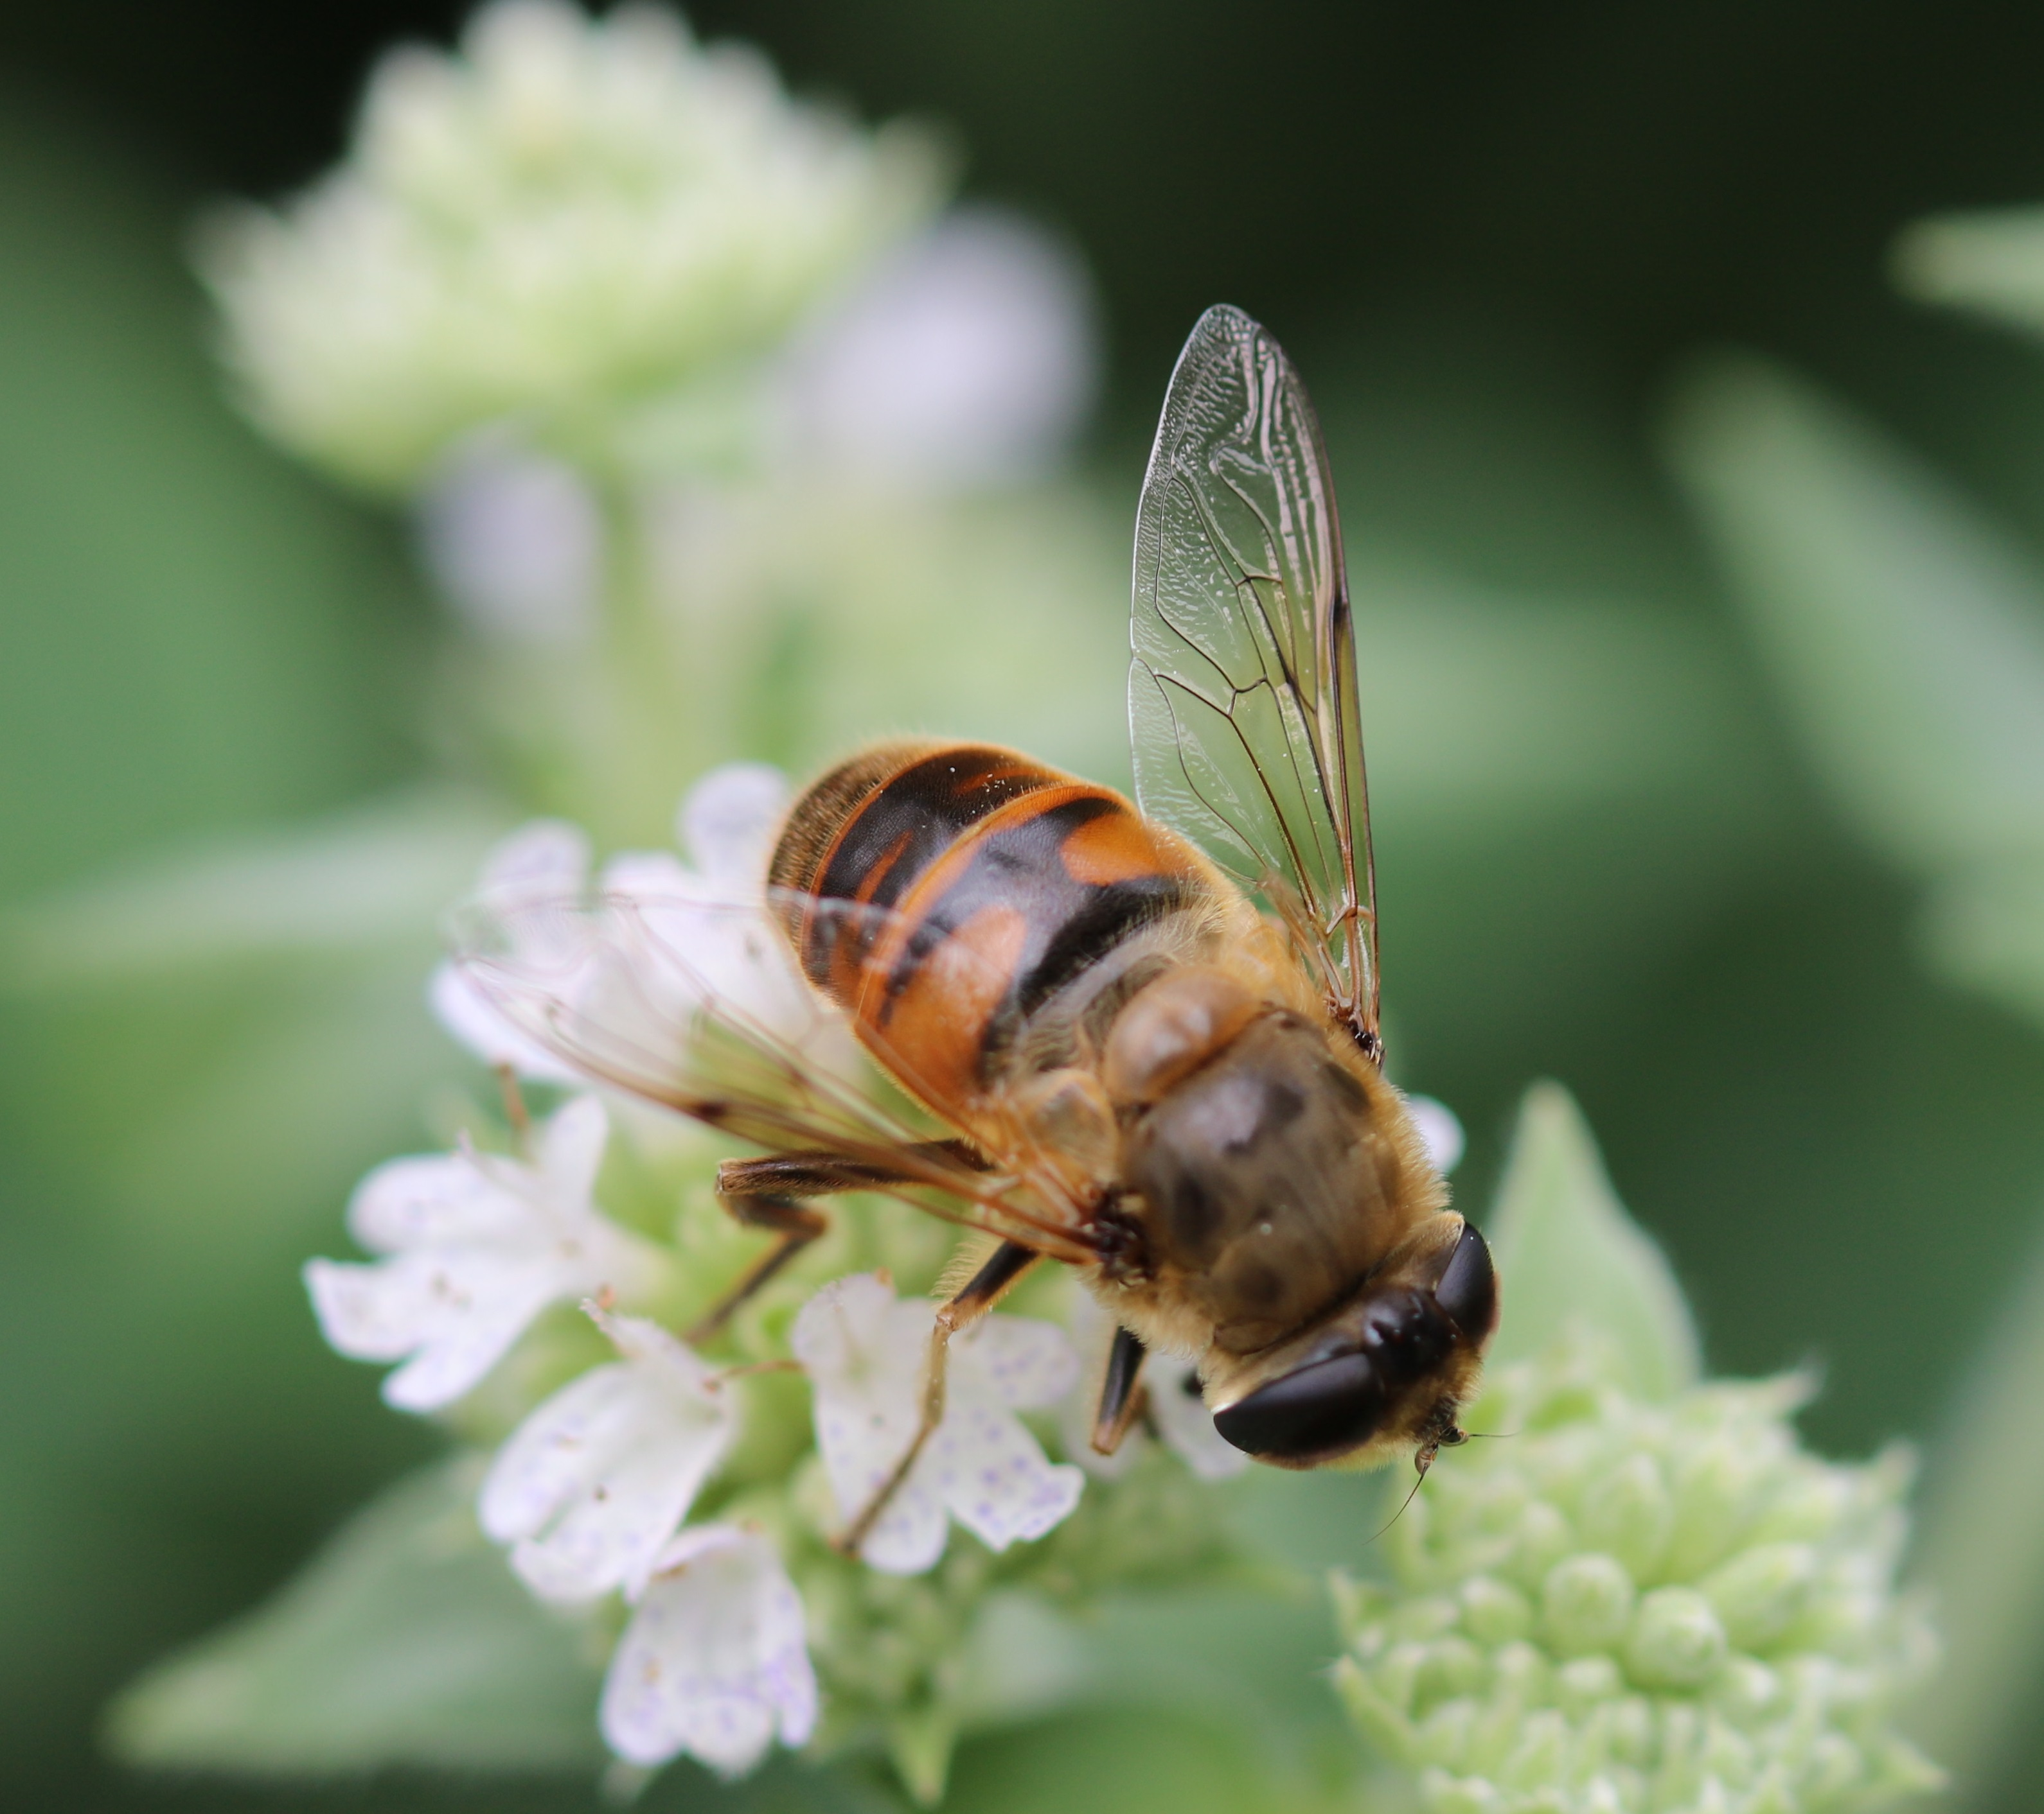
Syrphid Fly
Notice the very small antennae and that the eyes are close together with no ocelli. It is hard to tell if there are two wings or four wings hooked together. Often bees rest with their wings laying flat on their back. Do you see any pollen? No! This is a fly that resembles a bee, a bee mimic.

Slide 26
On this bumble bee you can see pollen in the pollen basket (corbicula). Also, notice the long antennae.

Slide 27
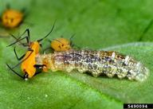
Syrphid Fly larva
Photo by David Cappaert, Bugwood.org
Notes:
Syrphid flies lay their eggs in gardens. The resulting larvae eat aphids!

Slide 28
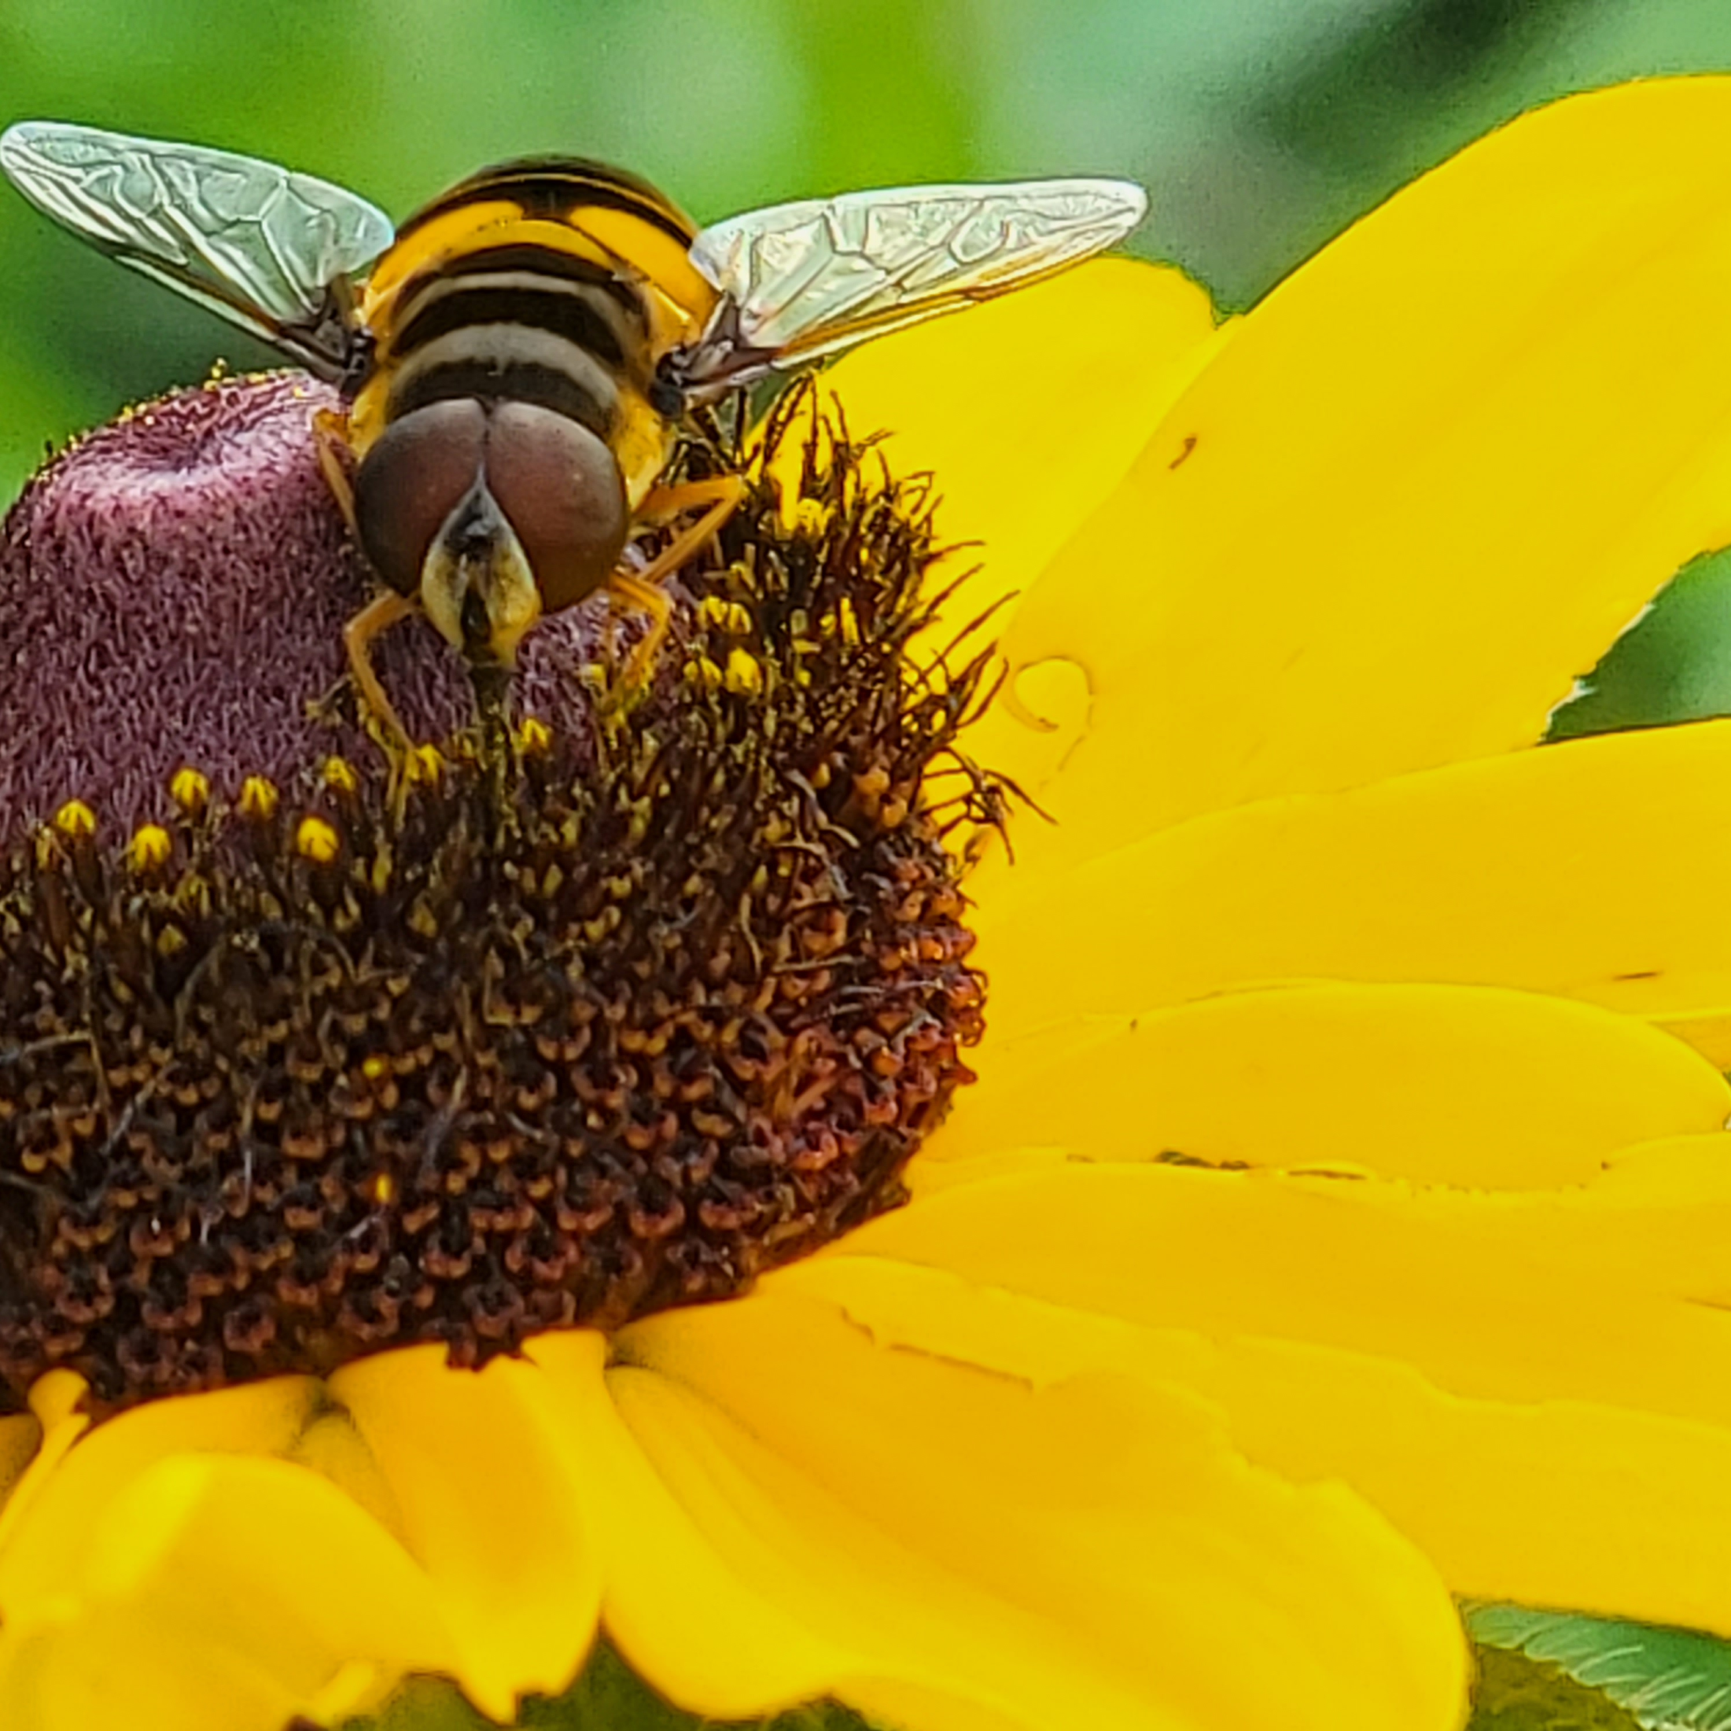
Question #2
Is this a bee or a fly?
Bee
Fly
Notes:
This is a fly!

Slide 29
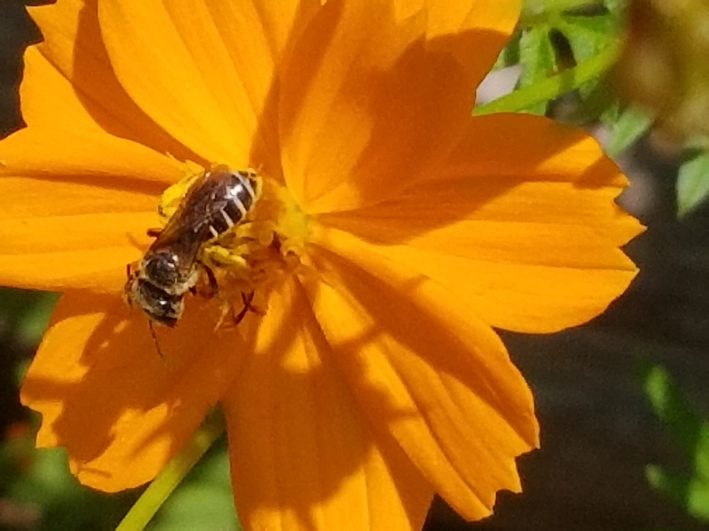
Question #3
In what category would you place this insect? (Hint: this is a cosmos flower.)
Small bee
Honey bee
Bumble bee
Fly
Notes:
Small bee

Slide 30

Butterflies and Moths

Slide 31




Butterflies
Gulf Fritillary
Monarch
Gray Hairstreak
Eastern Swallowtail
Notes:
You may see all of these during the Census

Slide 32




Other Insects
Notes:
Anything that doesn’t fit into any of the previous categories, goes into the “other insect” category

Slide 33

Question #4:
How would you count this insect during the Census?
Carpenter Bee
Bumble Bee
Honey Bee
Small Bee
Wasp
Fly
Butterfly/Moth
Other Insect
Notes:
Honey bee

Slide 34

Question #5
How would you count this insect during the Census?
Carpenter Bee
Bumble Bee
Honey Bee
Small Bee
Wasp
Fly
Butterfly/Moth
Other Insect
Notes:
Carpenter bee – see the bald abdomen

Slide 35

Question #6
How would you count this insect during the Census?
Carpenter Bee
Bumble Bee
Honey Bee
Small Bee
Wasp
Fly
Butterfly/Moth
Other Insect
Notes:
Other insect – lacewing larva covered in plant debris

Slide 36
https://GSePC.org

Slide 37
Counting in the
Great Southeast Pollinator Census
Becky Griffin
beckygri@uga.edu
National Coordinator for
The Great Southeast Pollinator Census

